Slide 1
ALT EKSTREMİTE KEMİKLERİ
Dr. Selçuk TUNALI
TOBB ETÜ Tıp Fakültesi, 12 Eylül 2014

Slide 2
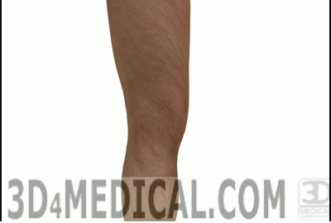
2
Selcuk Tunali, MD, PhD

Slide 3

Alt Ekstremite Kemikleri
Pelvis
Os coxae + Sacrum + Coccyx
Uyluk
Femur
Patella
Bacak
Tibia
Fibula
Ayak
Ossa tarsi
Ossa metatarsi
Phalanges
3
Selcuk Tunali, MD, PhD

Slide 4
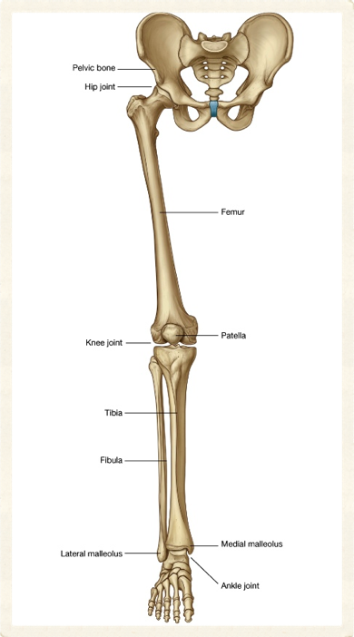
4
Selcuk Tunali, MD, PhD

Slide 5
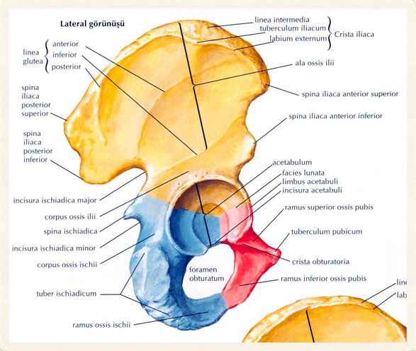
Os Coxae – 1
Coxae
Innominate bone
Ilium
Ischium
Pubis
5
Selcuk Tunali, MD, PhD

Slide 6
Os Coxae – 2
Symphysis pubica
Acetabulum
2/5 ilium
2/5 ischium
1/5 pubis
6
Selcuk Tunali, MD, PhD

Slide 7
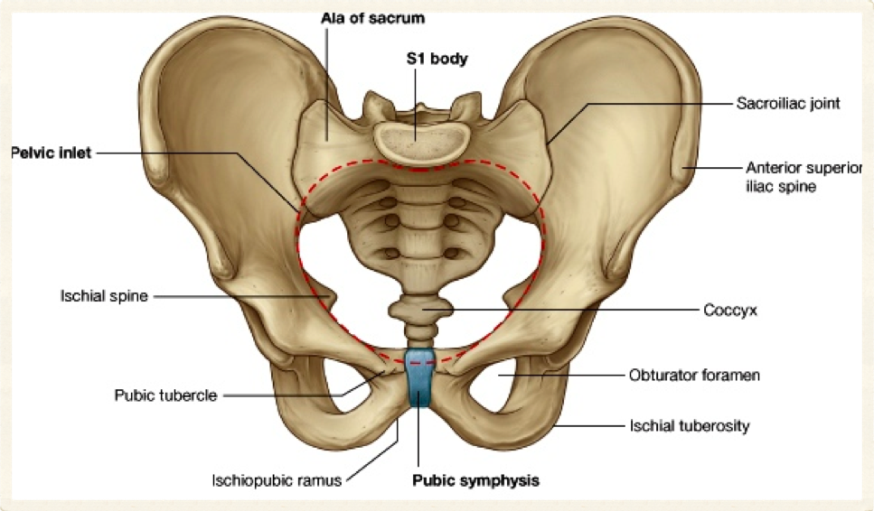
7
Selcuk Tunali, MD, PhD

Slide 8
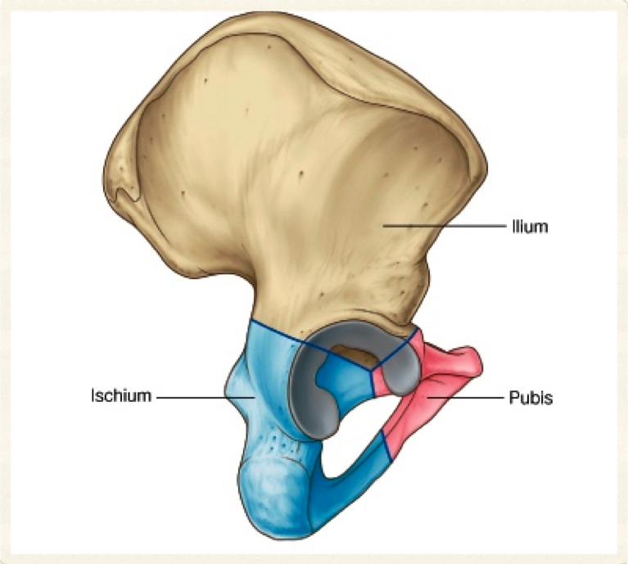
8
Selcuk Tunali, MD, PhD

Slide 9
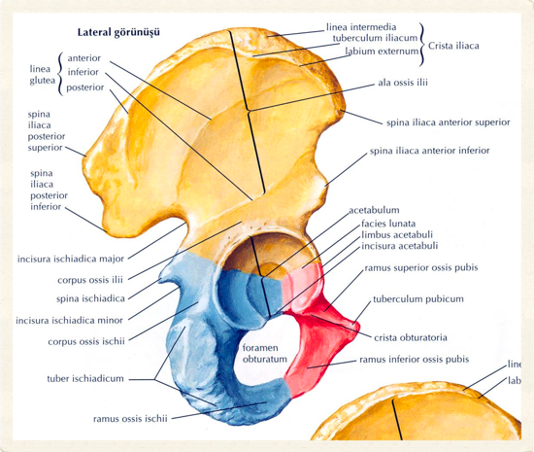
Ilium – 1
En büyük
Ala ossis ilii
Spina iliaca anterior superior
Spina iliaca anterior inferior
Spina iliaca posterior superior
Spina iliaca posterior inferior
9
Selcuk Tunali, MD, PhD

Slide 10
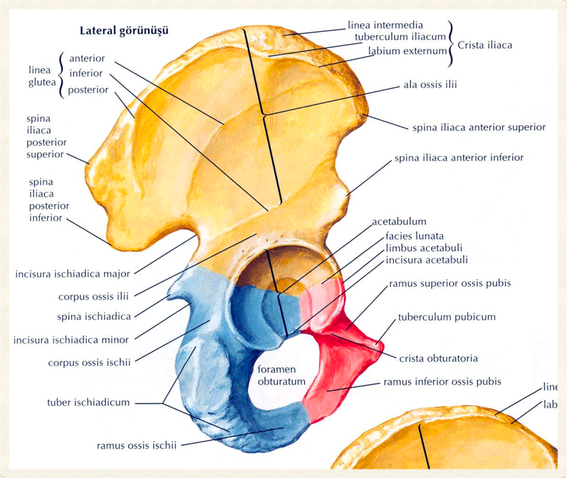
10
Selcuk Tunali, MD, PhD

Slide 11
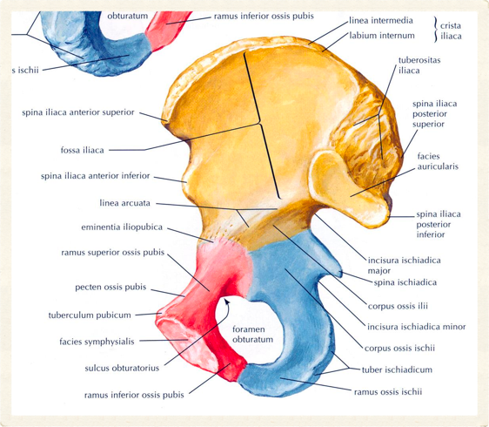
Ilium – 2
Linea arcuata
Incisura ischiadica major
Linea glutealis
Ant./post./inf.
Fossa iliaca
Facies auricularis
11
Selcuk Tunali, MD, PhD

Slide 12
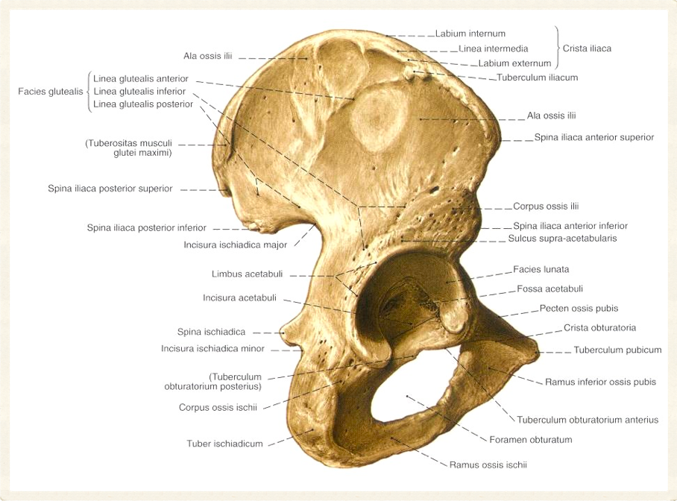
12
Selcuk Tunali, MD, PhD

Slide 13
Ischium
Corpus ossis ischii
Ramus ossis ischii
Foramen obturatum
Incisura ischiadica major
Incisura ischiadica minor
Spina ischiadica
Tuber ischiadicum
13
Selcuk Tunali, MD, PhD

Slide 14
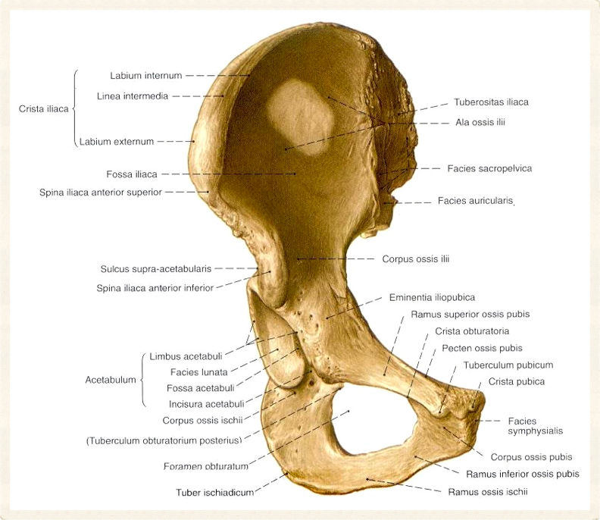
14
Selcuk Tunali, MD, PhD

Slide 15
Pubis
Corpus ossis pubis
Ramus sup. & inf.
Symphysis pubica
Crista pubica
Tuberculum pubicum
Pecten ossis pubis (linea pectinea)
Eminentia iliopubica
Crista obturatoria
15
Selcuk Tunali, MD, PhD

Slide 16
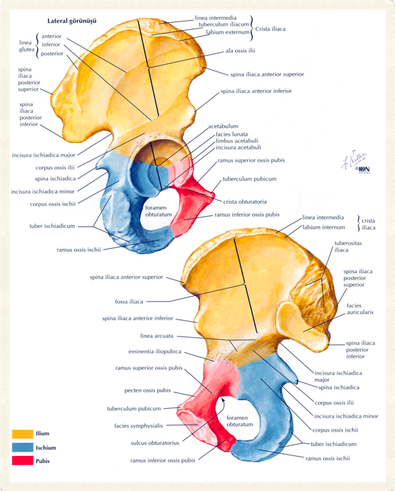
16
Selcuk Tunali, MD, PhD

Slide 17
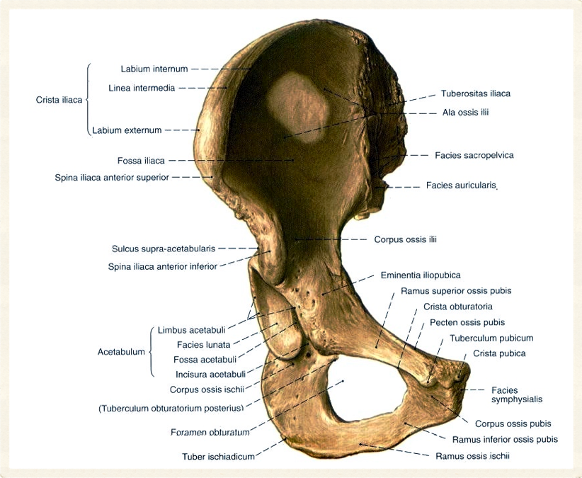
17
Selcuk Tunali, MD, PhD

Slide 18
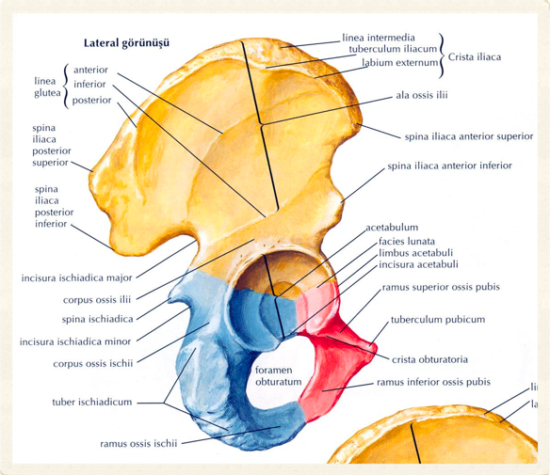
Os Coxae
Foramen obturatum
Pubis & ischium
Sulcus obturatorius
Acetabulum
Incisura acetabuli
Fossa acetabuli
Facies lunata
18
Selcuk Tunali, MD, PhD

Slide 19
Os Coxae
Anatomik pozisyonda
Spina iliaca anterior superior ile tuberculum pubicum aynı vertikal eksendedir
19
Selcuk Tunali, MD, PhD

Slide 20
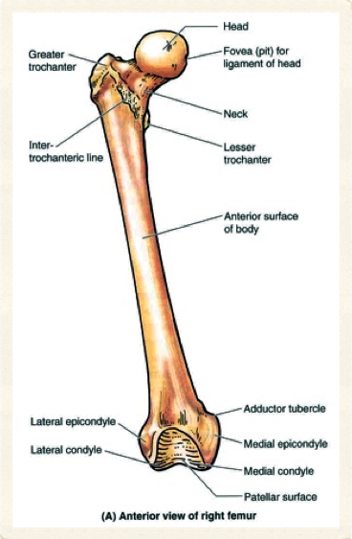
Femur – 1
Uyluk kemiği
En uzun
En ağır
Boyun 1/4’i uzunlukta
Caput femoris
Fovea capitis femoris
20
Selcuk Tunali, MD, PhD

Slide 21
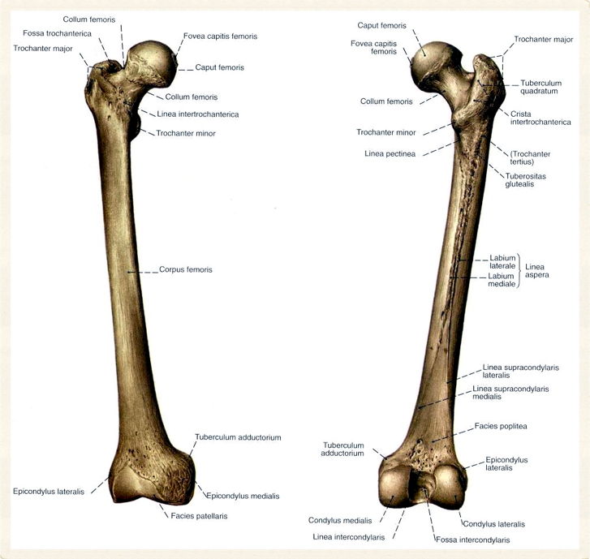
21
Selcuk Tunali, MD, PhD

Slide 22
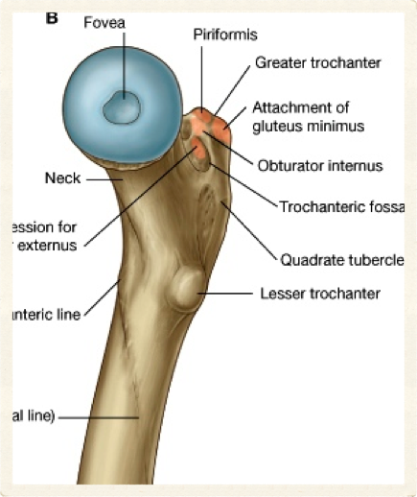
Femur – 2
Collum femoris
Açı 115 to 140º
Trochanter minor
Trochanter major
Linea intertrochanterica
Crista intertrochanterica
Fossa trochanterica
Tuberculum quadratum
22
Selcuk Tunali, MD, PhD

Slide 23
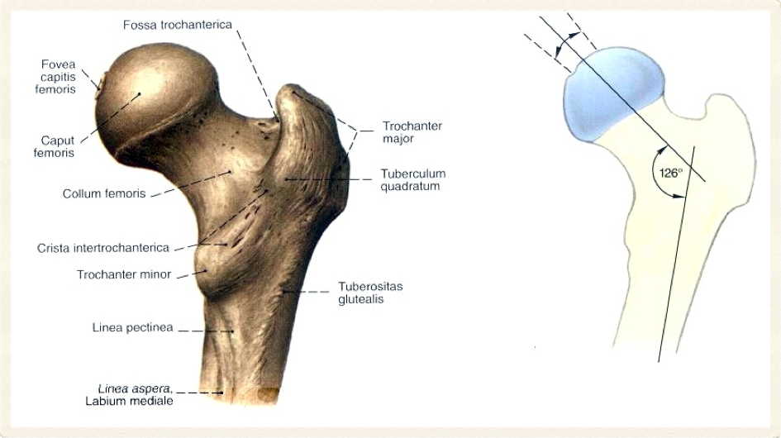
23
Selcuk Tunali, MD, PhD

Slide 24
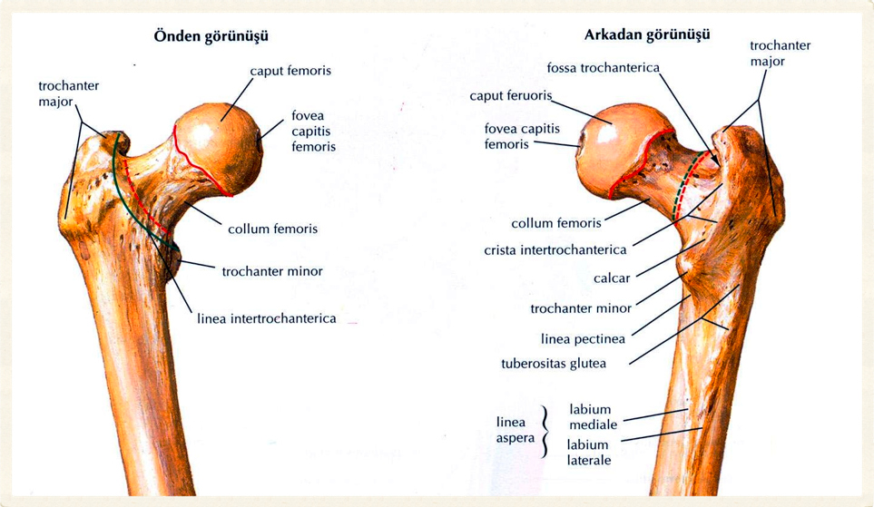
24
Selcuk Tunali, MD, PhD

Slide 25
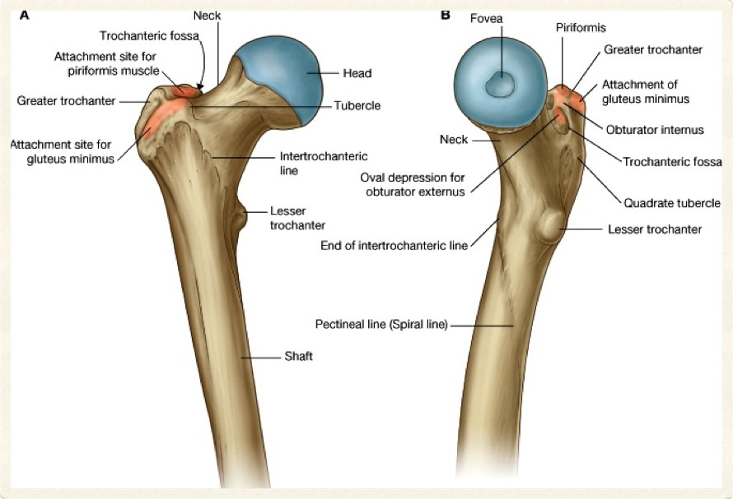
25
Selcuk Tunali, MD, PhD

Slide 26
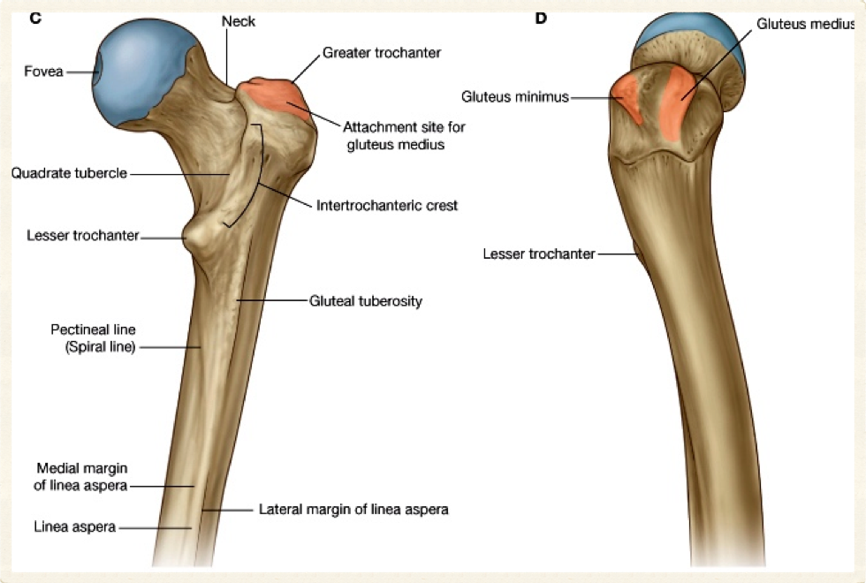
26
Selcuk Tunali, MD, PhD

Slide 27
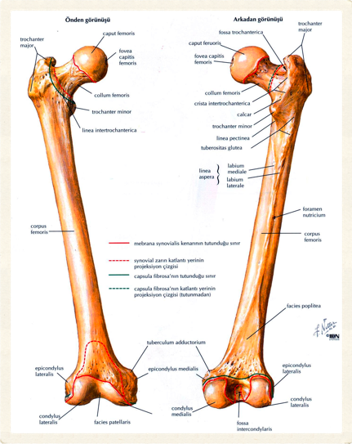
Femur – 3
Corpus femoris
Linea aspera
Labium mediale – üstte linea spiralis’e
Labium laterale – üstte tuberositas glutealis’e
27
Selcuk Tunali, MD, PhD

Slide 28
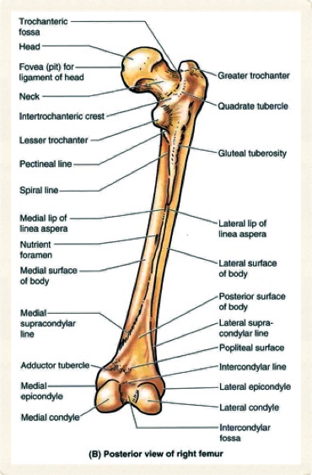
Femur – 4
Linea pectinea – linea aspera’nın ortasından trochanter minor’un tabanına
Linea supracondylaris med. & lat.
28
Selcuk Tunali, MD, PhD

Slide 29
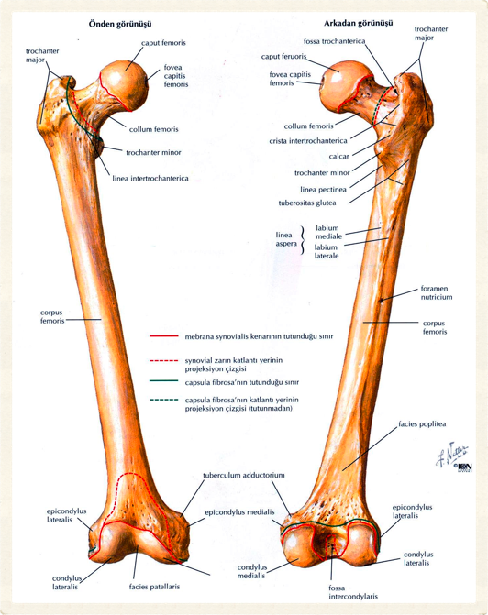
29
Selcuk Tunali, MD, PhD

Slide 30
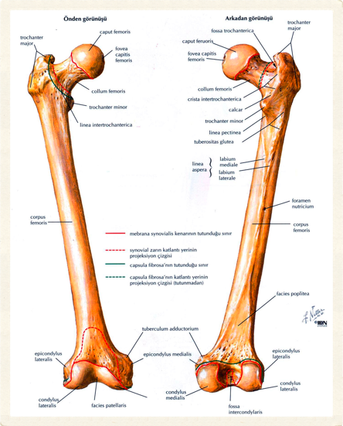
Femur – 5
Condylus med. & lat.
Fossa intercondylaris
Facies patellaris
Facies poplitealis
Epicondylus lateralis
Epicondylus medialis
Tuberculum adductorium
30
Selcuk Tunali, MD, PhD

Slide 31
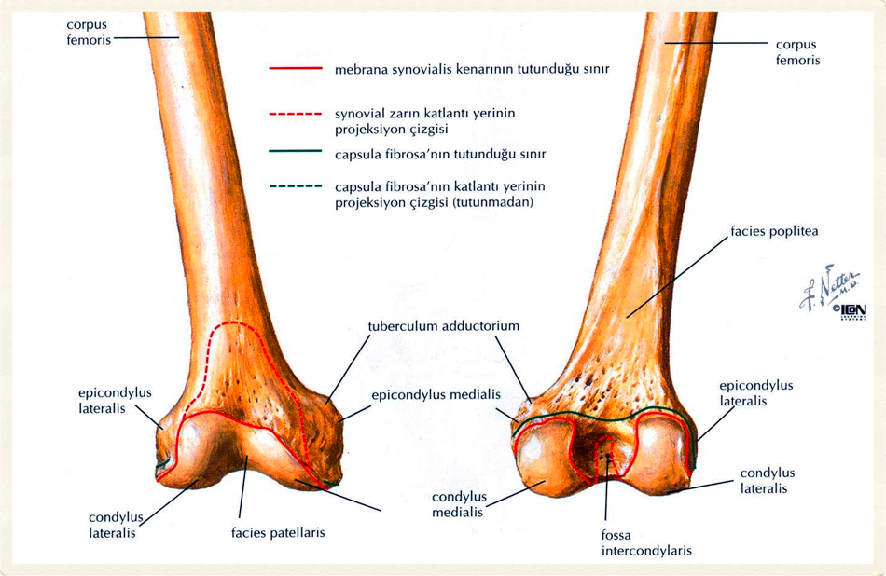
31
Selcuk Tunali, MD, PhD

Slide 32
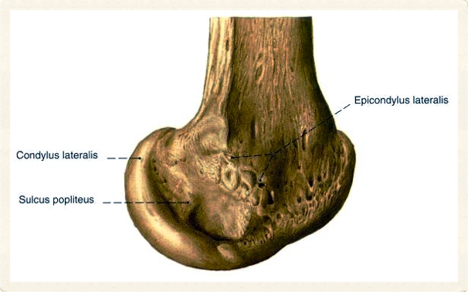
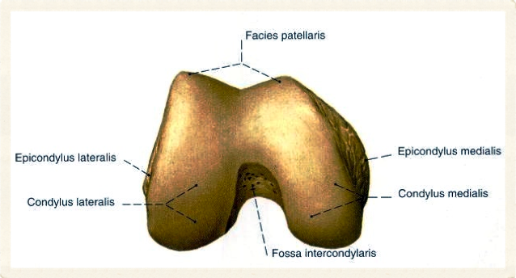
32
Selcuk Tunali, MD, PhD

Slide 33
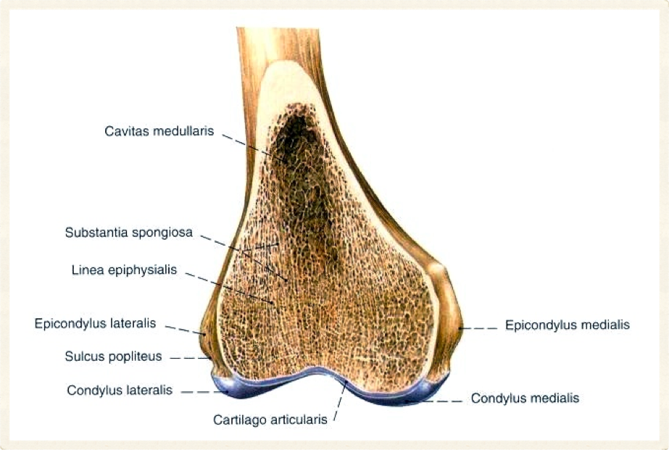
33
Selcuk Tunali, MD, PhD

Slide 34
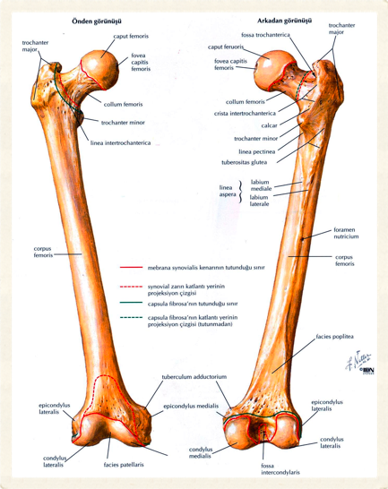
Femur – 6
Kas ve ligament bağlanma yerleri
Trochanter
Linea
Tuberculum
Epicondylus
34
Selcuk Tunali, MD, PhD

Slide 35
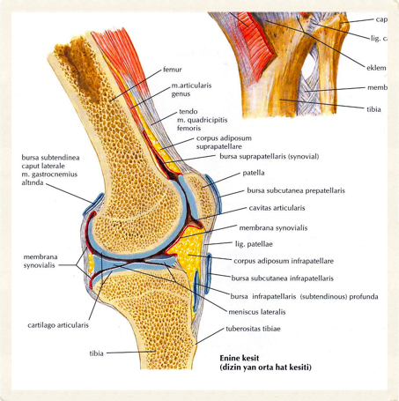
Patella
En büyük sesamoid kemik
Apex
Basis
Facies ant. & post.
35
Selcuk Tunali, MD, PhD

Slide 36
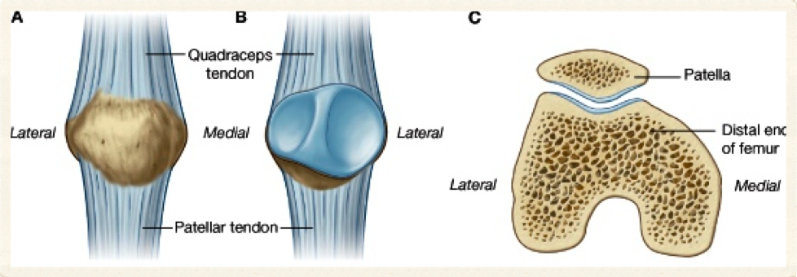
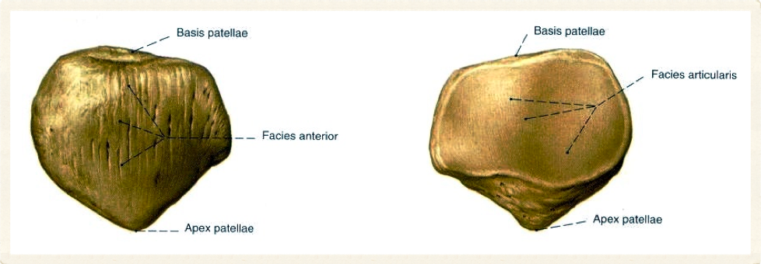
36
Selcuk Tunali, MD, PhD

Slide 37
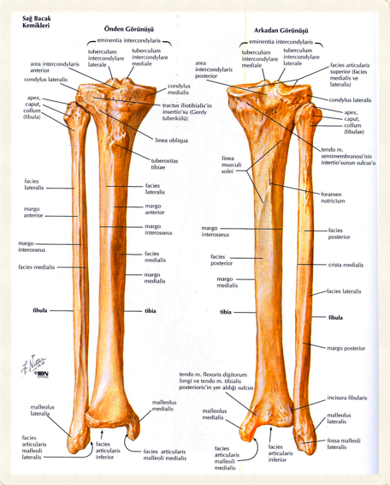
Tibia – 1
Vücut ağırlığını taşır
Bacağın anteromediali
Extremitas proximalis
Condylus medialis
Condylus lateralis
Facies articularis superior (tibial plateau)
37
Selcuk Tunali, MD, PhD

Slide 38
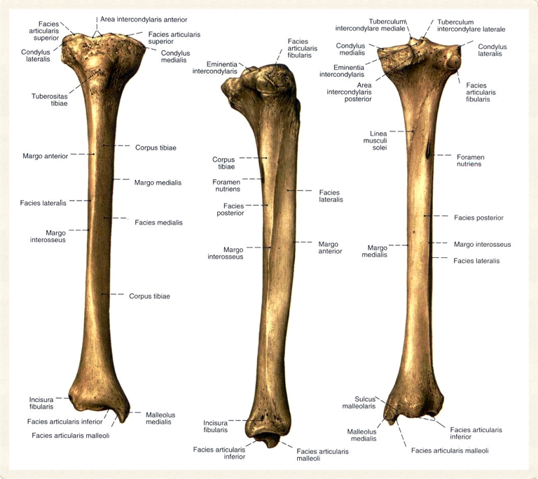
38
Selcuk Tunali, MD, PhD

Slide 39
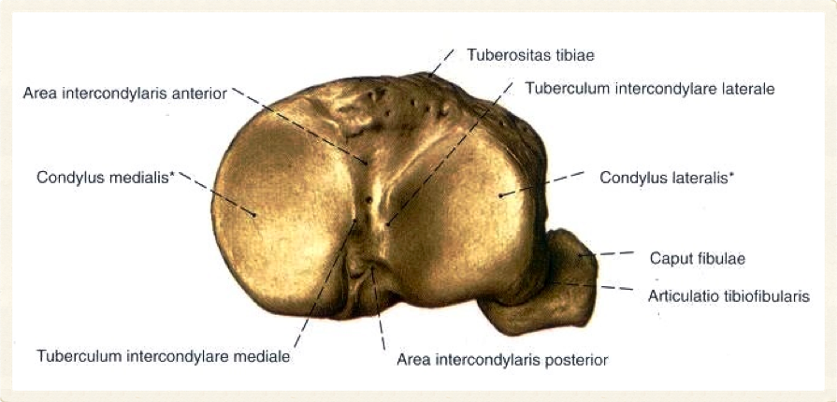
39
Selcuk Tunali, MD, PhD

Slide 40
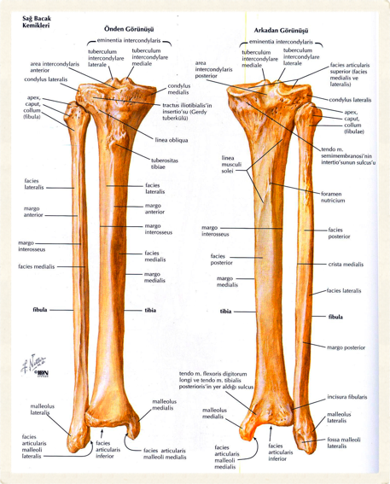
Tibia – 2
Area intercondylaris ant. & post.
Tuberositas tibiae
Facies articularis fibularis
Margo anterior – cilt altında
Linea musculi solei
40
Selcuk Tunali, MD, PhD

Slide 41
41
Selcuk Tunali, MD, PhD

Slide 42
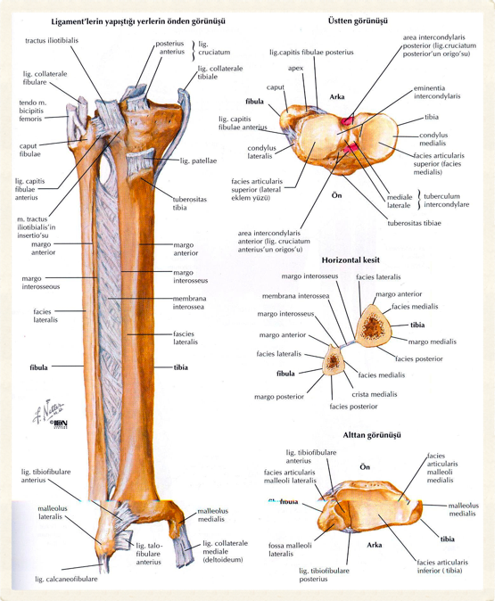
42
Selcuk Tunali, MD, PhD

Slide 43
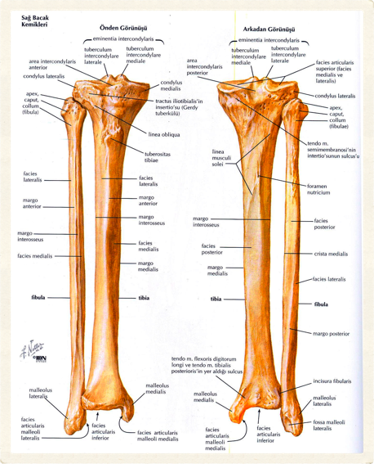
Tibia – 3
Extremitas distalis
Malleolus medialis
Incisura fibularis
Malleolus medialis
Sulcus malleolaris
Facies articularis malleoli
43
Selcuk Tunali, MD, PhD

Slide 44
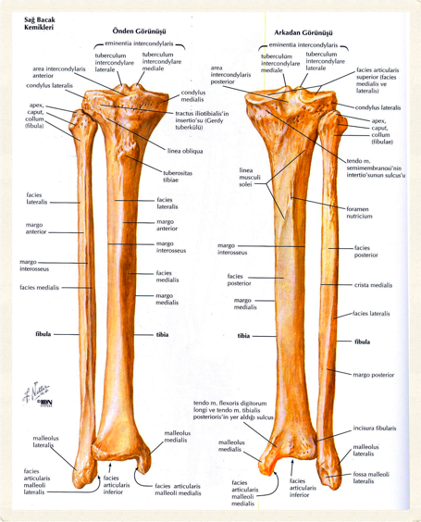
Tibia – 4
Sulcus
Tendo m. tibialis posterioris
Tendo m. flexoris digitorum longi
44
Selcuk Tunali, MD, PhD

Slide 45

Fibula – 1
Bacak posterolaterali
Vücut ağırlığı taşımaz
Caput fibulae
Apex capitis fibulae
Corpus fibulae
Malleolus lateralis
45
Selcuk Tunali, MD, PhD

Slide 46
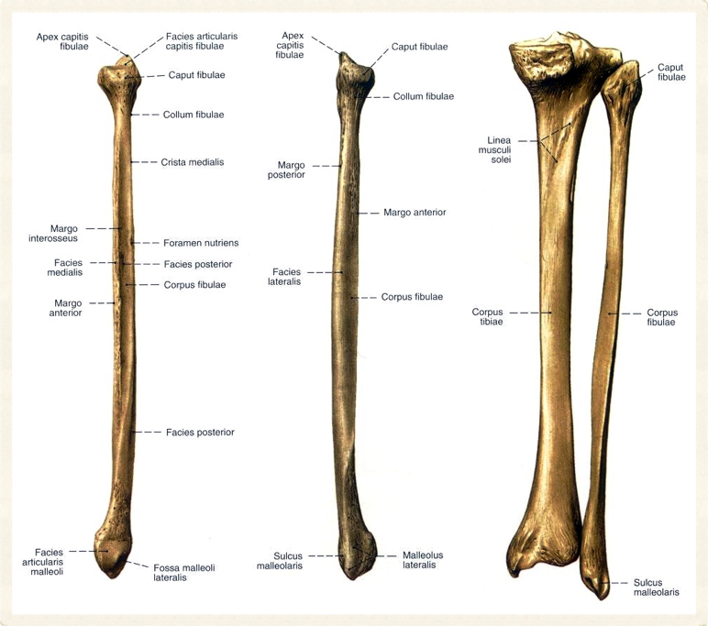
46
Selcuk Tunali, MD, PhD

Slide 47
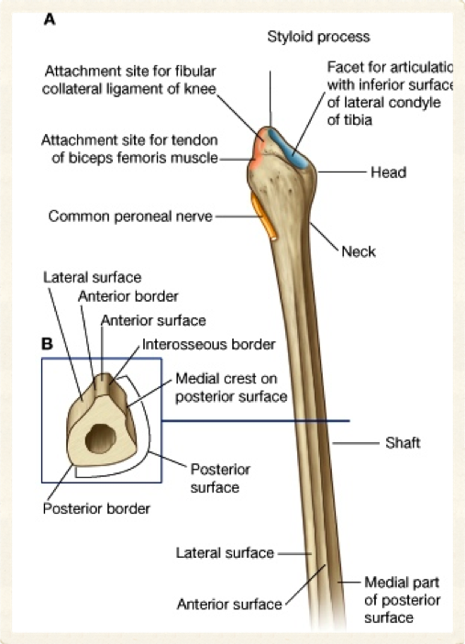
47
Selcuk Tunali, MD, PhD

Slide 48
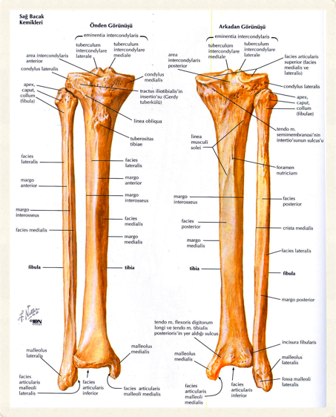
Fibula – 2
2/3 üst
Margo ant., post. (lat), interosseus & crista medialis
1/3 alt
Crista medialis, margo interosseus ile birleşir
Facies ant. yok
48
Selcuk Tunali, MD, PhD

Slide 49
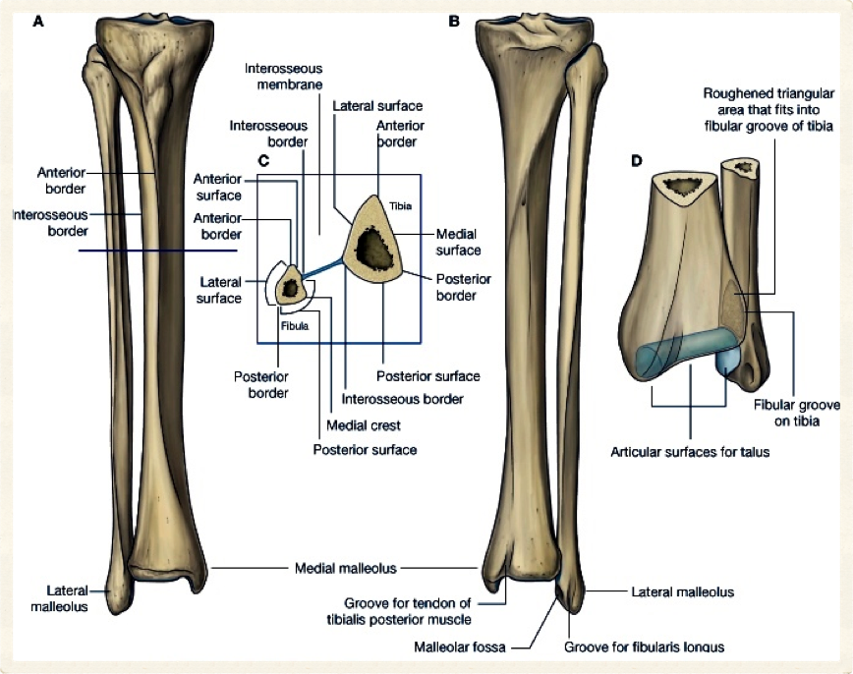
49
Selcuk Tunali, MD, PhD

Slide 50
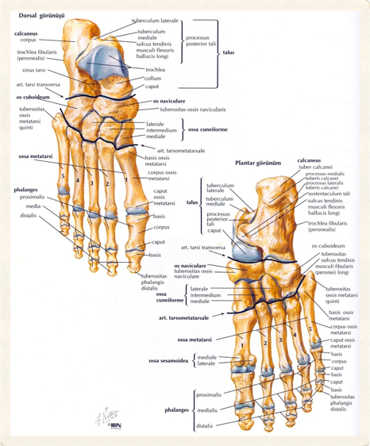
Ossa Tarsi
Ayak bileği kemikleri
Talus
Calcaneus
Os naviculare
Ossa cuneiforme
Os cuboideum
50
Selcuk Tunali, MD, PhD

Slide 51
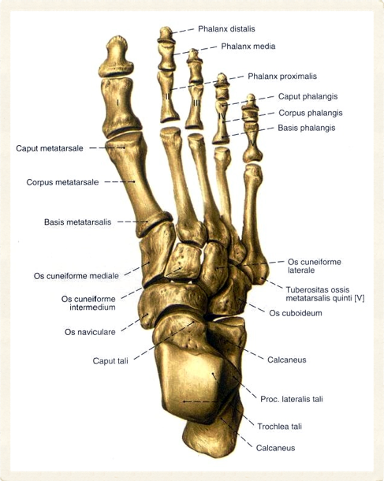
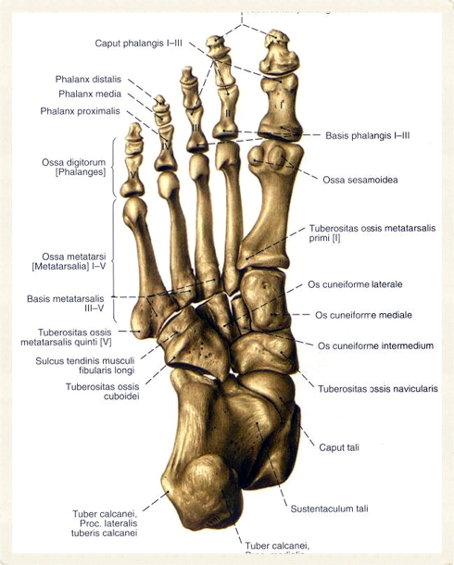
51
Selcuk Tunali, MD, PhD

Slide 52
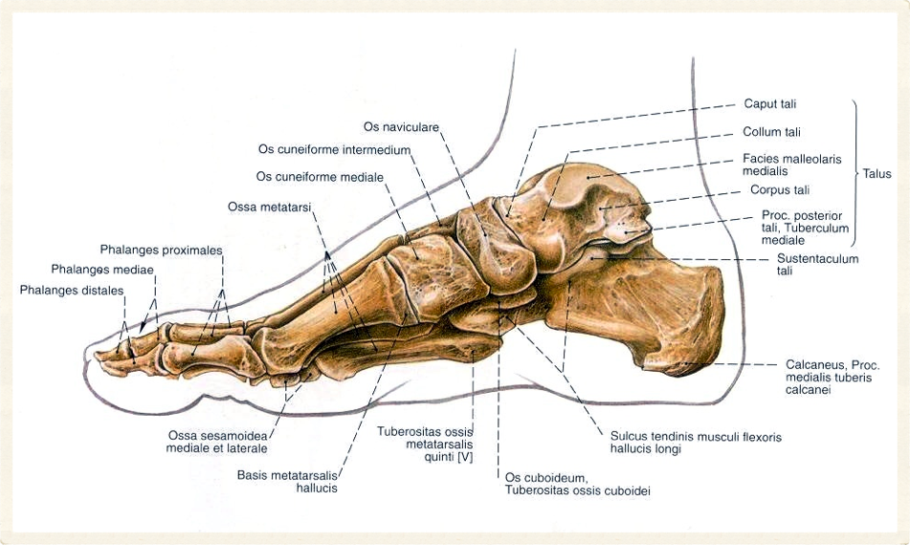
52
Selcuk Tunali, MD, PhD

Slide 53
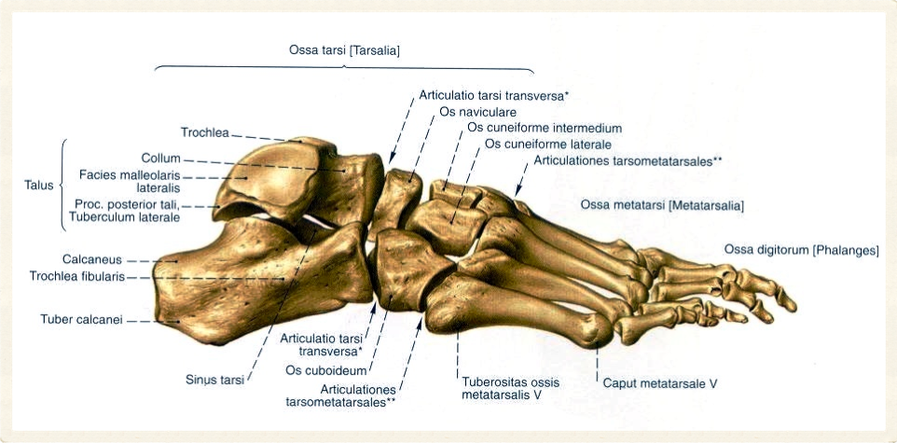
53
Selcuk Tunali, MD, PhD

Slide 54
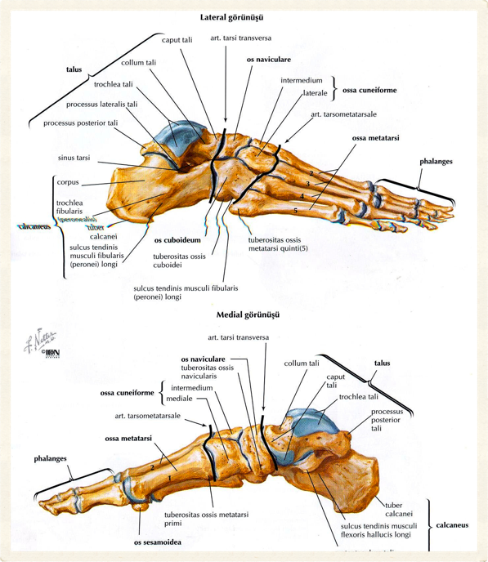
54
Selcuk Tunali, MD, PhD

Slide 55
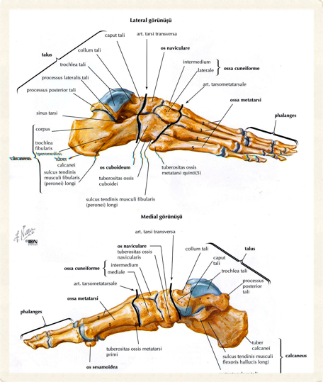
Talus – 1
İkinci büyüklükte
Caput → calcaneus & os naviculare ile eklem
Collum tali
Corpus tali
Sulcus tali
Trochlea tali → tibia, fibula
55
Selcuk Tunali, MD, PhD

Slide 56

Talus – 2
Processus lateralis tali
Processus posterior tali
Tuberculum laterale
Tuberculum mediale
Sulcus tendinis m. flexoris hallucis longi
56
Selcuk Tunali, MD, PhD

Slide 57

57
Selcuk Tunali, MD, PhD

Slide 58

58
Selcuk Tunali, MD, PhD

Slide 59

59
Selcuk Tunali, MD, PhD

Slide 60

60
Selcuk Tunali, MD, PhD

Slide 61

61
Selcuk Tunali, MD, PhD

Slide 62

Calcaneus
En büyük tarsal
6 yüz
Sustentaculum tali
Trochlea fibularis
Tuber calcanei
Sulcus tendinis m. peronei longi
Sulcus tendinis m. flexoris hallucis longi
62
Selcuk Tunali, MD, PhD

Slide 63

63
Selcuk Tunali, MD, PhD

Slide 64

64
Selcuk Tunali, MD, PhD

Slide 65
65
Selcuk Tunali, MD, PhD

Slide 66

66
Selcuk Tunali, MD, PhD

Slide 67

Os Naviculare
Ön → ossa cuneiforme
Arka → talus
Lateral → os cuboideum
67
Selcuk Tunali, MD, PhD

Slide 68
Os Cuboideum
Ön → basis ossi metatarsi 4–5
Arka → calcaneus
Medial → os cuneiformis lat. & os naviculare
Sulcus tendinis m. peronei longi
68
Selcuk Tunali, MD, PhD

Slide 69

69
Selcuk Tunali, MD, PhD

Slide 70
Ossa Cuneiforme
Os cuneiformis
Medialis (en büyük)
Lateralis
Intermedium (en küçük)
Ön → basis ossi metatarsi 1–3
Arka → os naviculare
70
Selcuk Tunali, MD, PhD

Slide 71
71
Selcuk Tunali, MD, PhD

Slide 72

72
Selcuk Tunali, MD, PhD

Slide 73
Ossa Metatarsi & Phalanges
Ossa metatarsi
5
Basis
Corpus
Caput
I → kısa & kalın
II → uzun
Phalanges
3
Basis
Corpus
Caput

Slide 74

74
Selcuk Tunali, MD, PhD

Slide 75

75
Selcuk Tunali, MD, PhD

Slide 76

76
Selcuk Tunali, MD, PhD

Slide 77

77
Selcuk Tunali, MD, PhD

Slide 78

78
Selcuk Tunali, MD, PhD

Slide 79

stunali@etu.edu.tr
selcuk@hawaii.edu
http://twitter.com/tunalis
http://www.tunalis.org

