Slide 1
ÜST EKSTREMİTE EKLEMLERİ
Dr. Selçuk Tunalı
TOBB ETÜ Tıp Fakültesi, 9 Eylül 2014

Slide 2
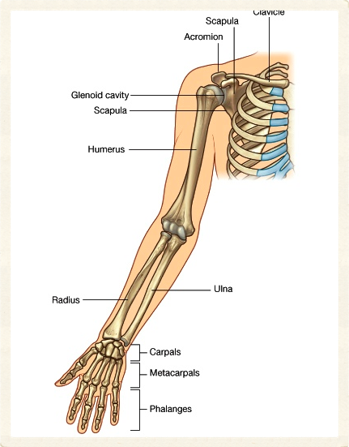
Omuz Kavşağı
Cinguli pectoralis
Articulatio (art.) sternoclavicularis
Art. acromioclavicularis
Art. (humeri) glenohumeralis
Birlikte hareket ederler
2
Selcuk Tunali, MD, PhD

Slide 3
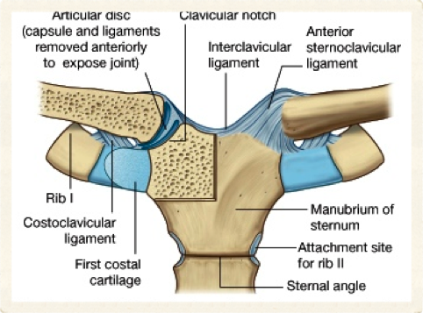
Art. Sternoclavicularis – 1
Üst ekstremite ile aksiyal iskelet arasındaki tek eklem
Facies articularis sternalis (clavicula)
Manubrium sterni & 1. kıkırdak kosta
Eklem yüzlerinde fibröz kıkırdak
3
Selcuk Tunali, MD, PhD

Slide 4
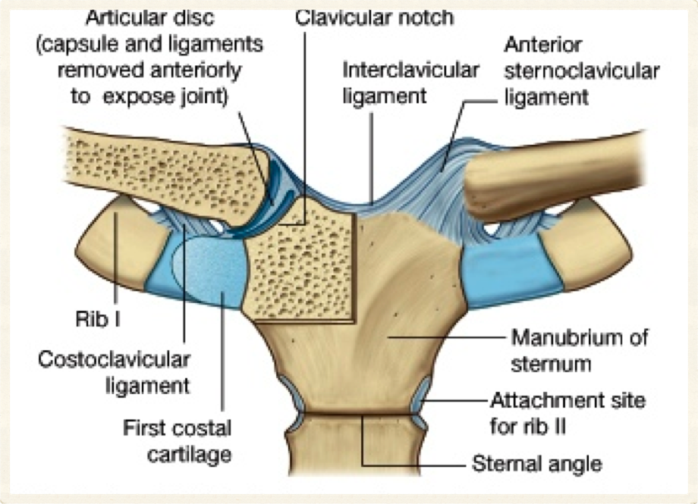
4
Selcuk Tunali, MD, PhD

Slide 5
Art. Sternoclavicularis – 2
Art. sellaris
Discus articularis
Capsula articularis
Ligamentum (lig.) sternoclavicularis anterius
Lig. sternoclavicularis posterius
Lig. costoclaviculare
Lig. interclaviculare
5
Selcuk Tunali, MD, PhD

Slide 6
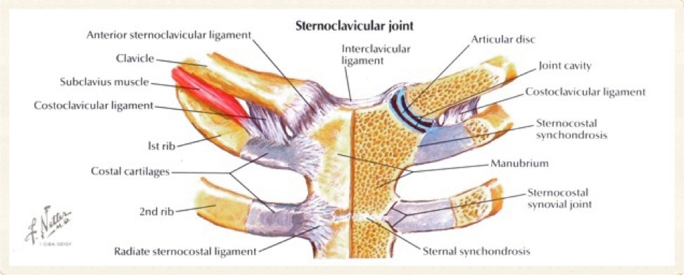
6
Selcuk Tunali, MD, PhD

Slide 7
Art. Sternoclavicularis – 3
Son derece sağlam
Sirkumdiksiyon
25 – 30 dereceye kadar rotasyon
7
Selcuk Tunali, MD, PhD

Slide 8
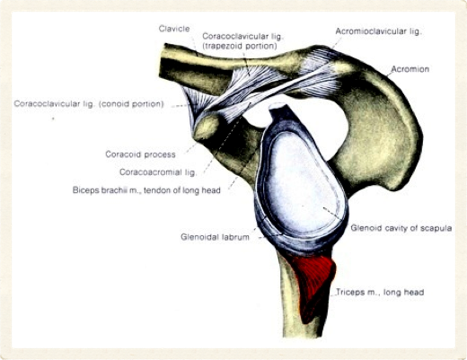
Art. Acromioclavicularis – 1
Art. plana
Facies articularis acromialis (clavicula)
Facies acromialis acromii (scapula)
Eklem yüzlerinde fibröz kıkırdak
Discus articularis
8
Selcuk Tunali, MD, PhD

Slide 9
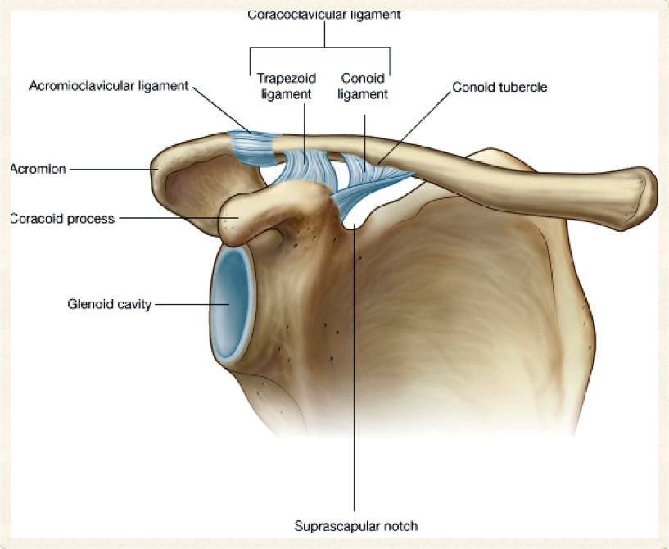
9
Selcuk Tunali, MD, PhD

Slide 10
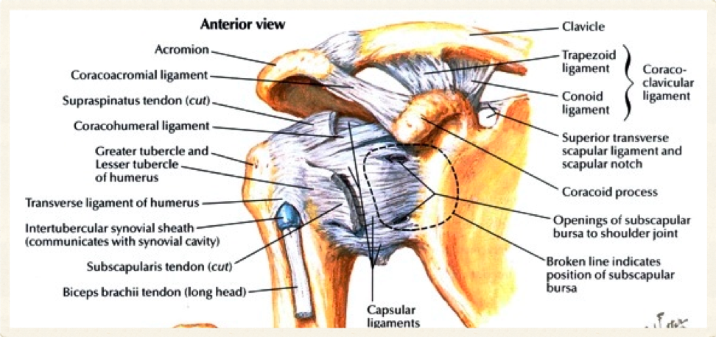
10
Selcuk Tunali, MD, PhD

Slide 11
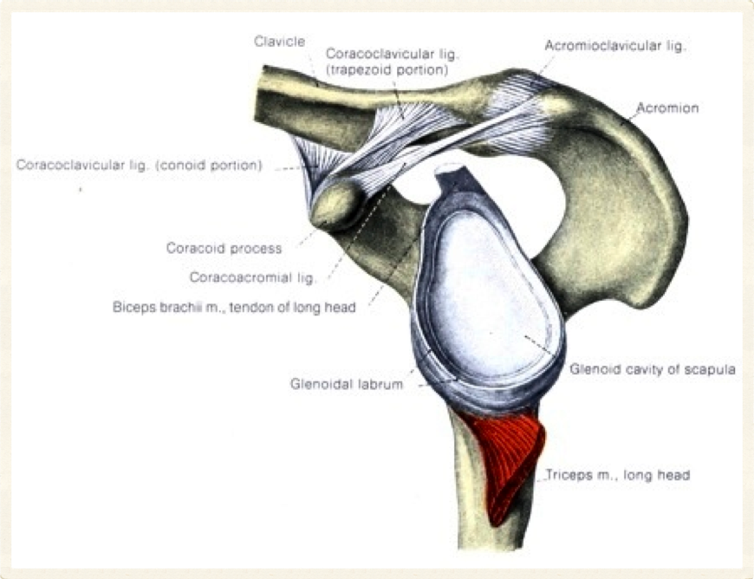
11
Selcuk Tunali, MD, PhD

Slide 12
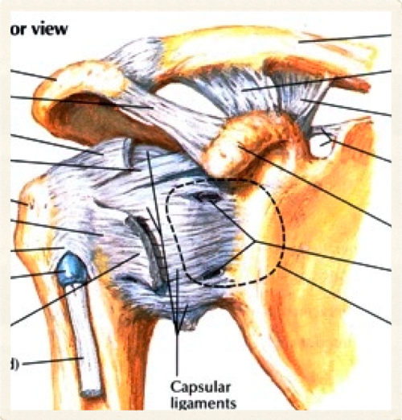
Art. Acromioclavicularis – 2
Capsula articularis
Lig. acromioclavicularis
Lig. coracoclaviculare
Lig. conoideum
Lig. trapezoideum
Scapula’ya rotasyon ve kayma hareketi
12
Selcuk Tunali, MD, PhD

Slide 13
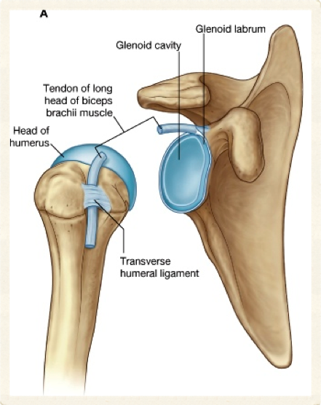
Art. Humeri – 1
Art. glenohumeralis
Art. spheroidea
Caput humeri
Cavitas glenoidalis
Labrum glenoidale
Eklem yüzleri hyalin kıkırdak
13
Selcuk Tunali, MD, PhD

Slide 14
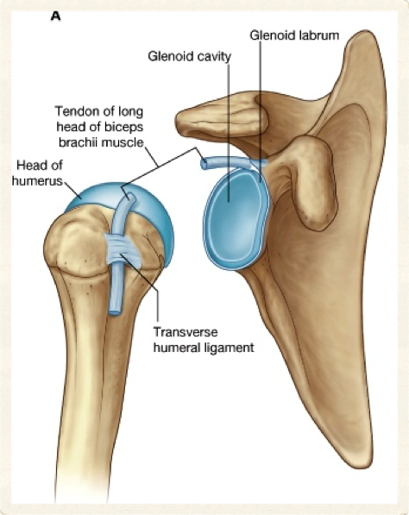
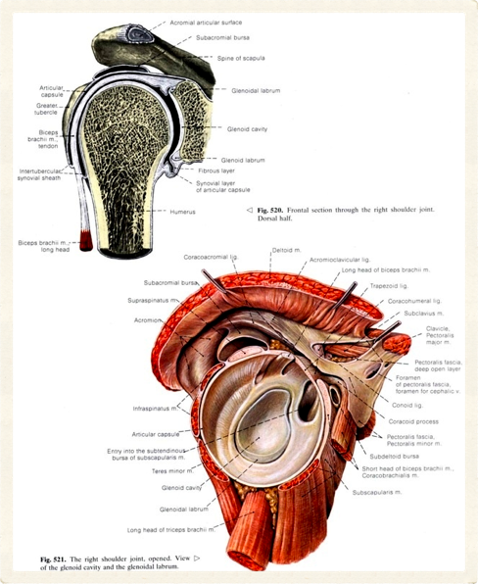
14
Selcuk Tunali, MD, PhD

Slide 15
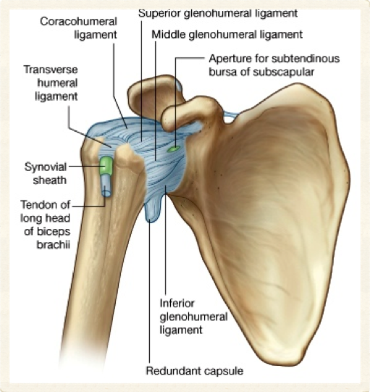
Art. Humeri – 2
Capsula articularis
Cavitas glenoidalis kenarı
Collum anatomicum
İçinden m. biceps brachii caput longum geçer
Bursa subscapularis ile eklem boşluğunu bağlayan açıklık
15
Selcuk Tunali, MD, PhD

Slide 16
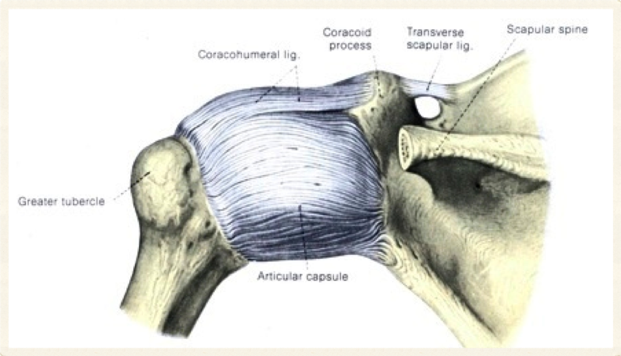
16
Selcuk Tunali, MD, PhD

Slide 17
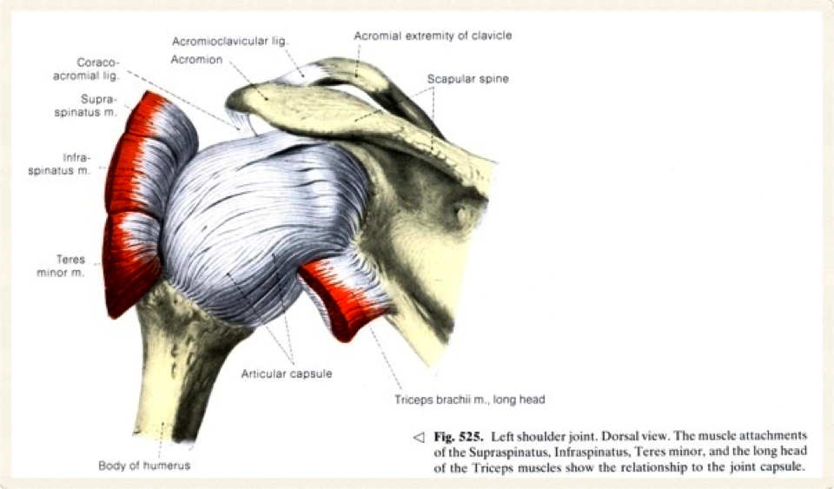
17
Selcuk Tunali, MD, PhD

Slide 18
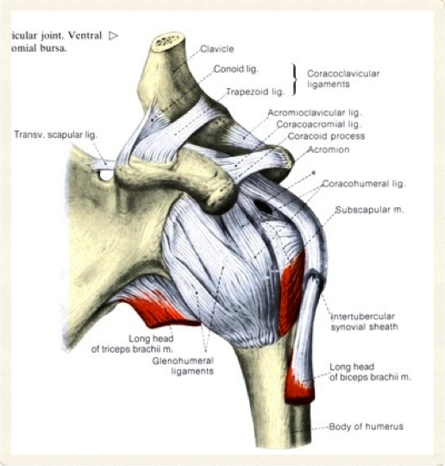
Art. Humeri – 3
Ligg. glenohumeralia
Eklem kapsülünün kalınlaşmasıyla oluşan 3 fibröz bant
Lig. coracohumerale
Lig. transversum humeri
Lig. coracoacromiale
18
Selcuk Tunali, MD, PhD

Slide 19
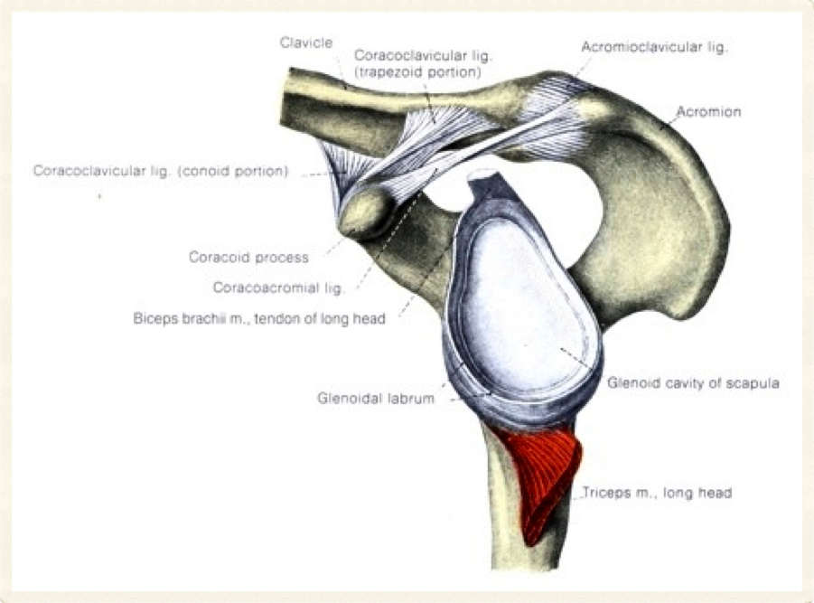
19
Selcuk Tunali, MD, PhD

Slide 20
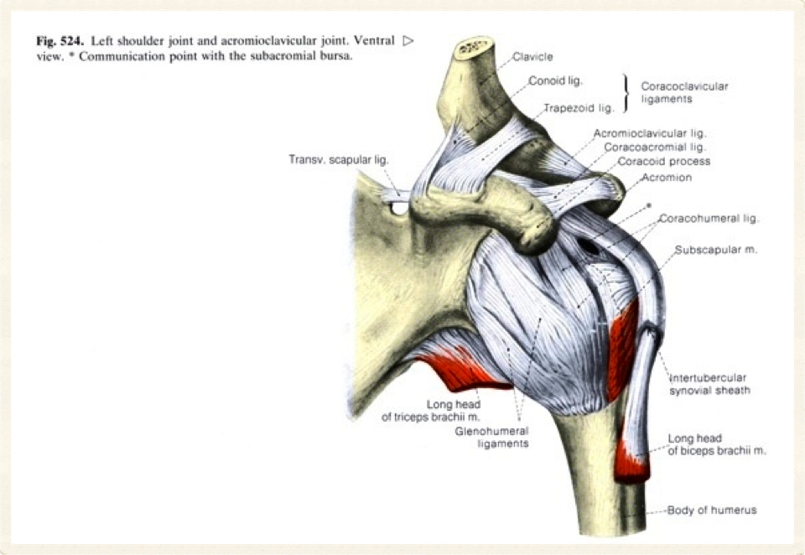
20
Selcuk Tunali, MD, PhD

Slide 21
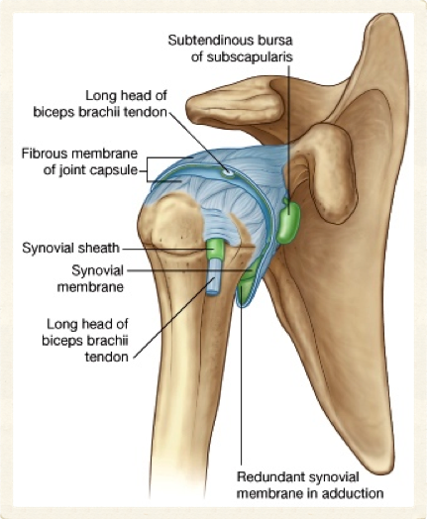
Art. Humeri – 4
Bursae
Subacromialis
Subdeltoidea
Subscapularis (bursa subtendinea m. subscap.)
Fleksiyon – ekstansiyon
Abduksiyon – adduksiyon
İç & dış rotasyon
Sirkumdiksiyon
21
Selcuk Tunali, MD, PhD

Slide 22
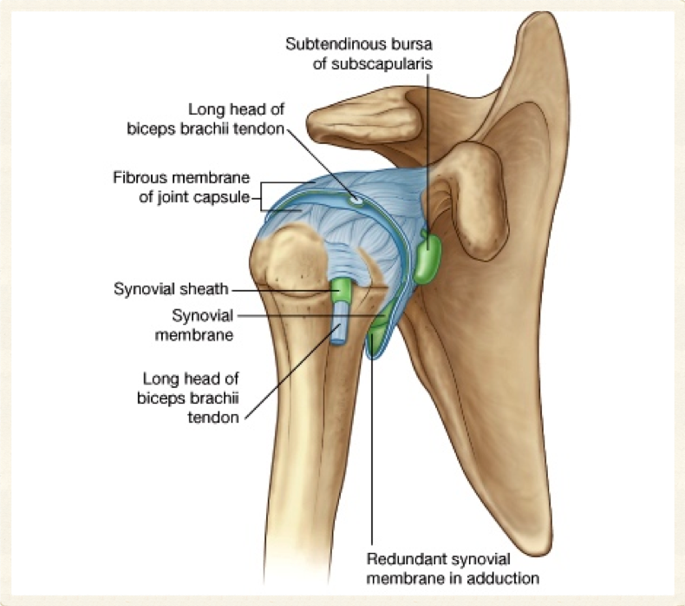
22
Selcuk Tunali, MD, PhD

Slide 23
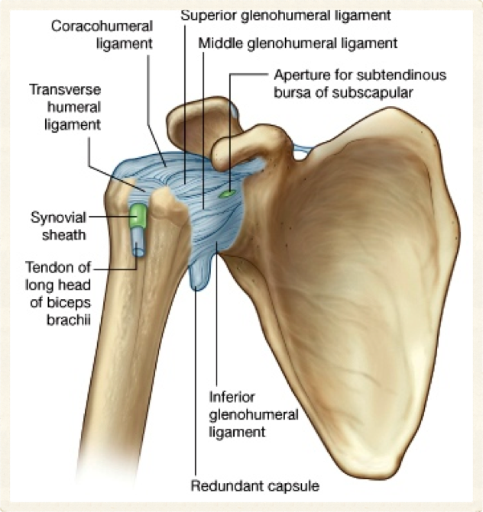
23
Selcuk Tunali, MD, PhD

Slide 24
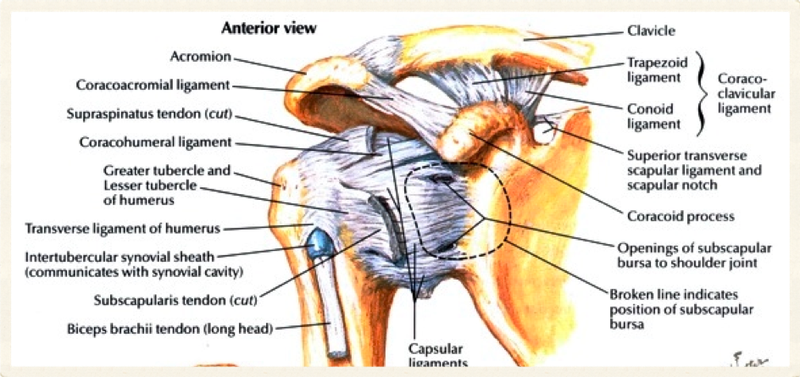
24
Selcuk Tunali, MD, PhD

Slide 25
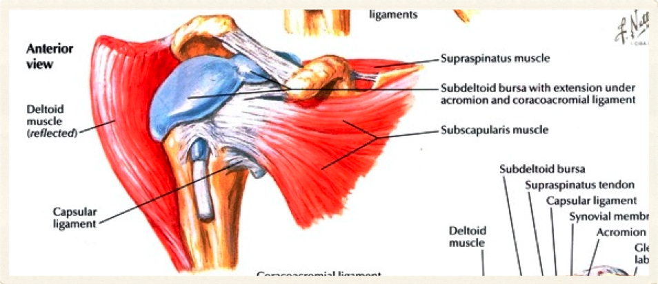
25
Selcuk Tunali, MD, PhD

Slide 26
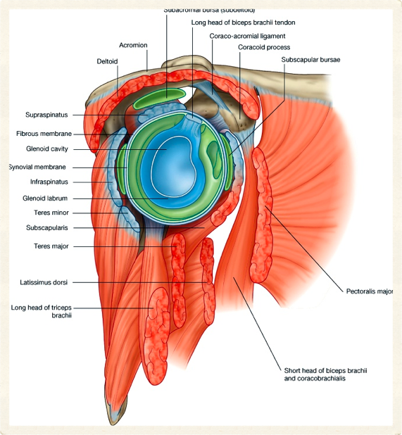
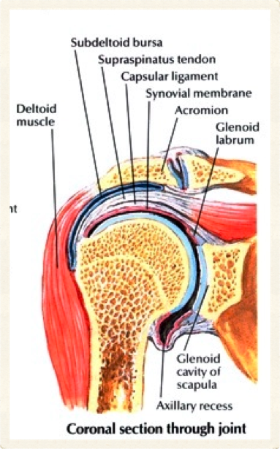
26
Selcuk Tunali, MD, PhD

Slide 27
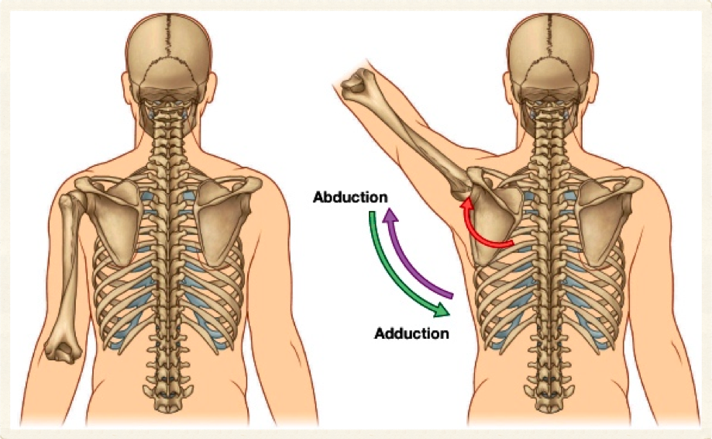
27
Selcuk Tunali, MD, PhD

Slide 28
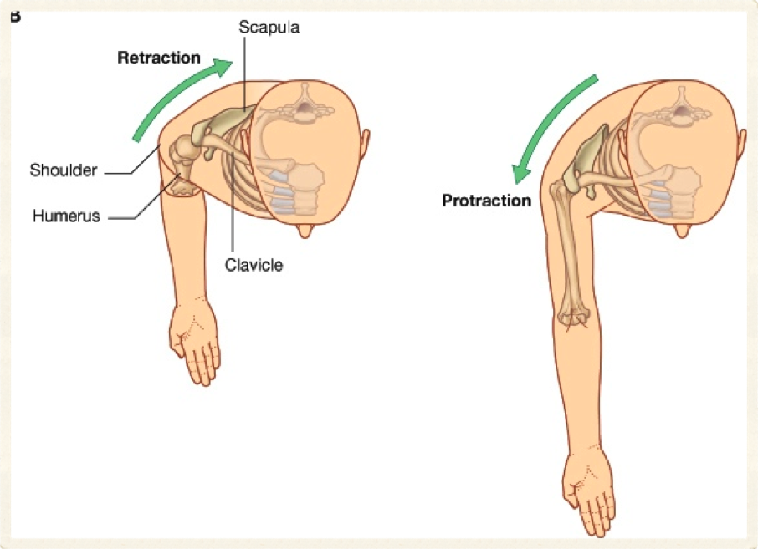
28
Selcuk Tunali, MD, PhD

Slide 29
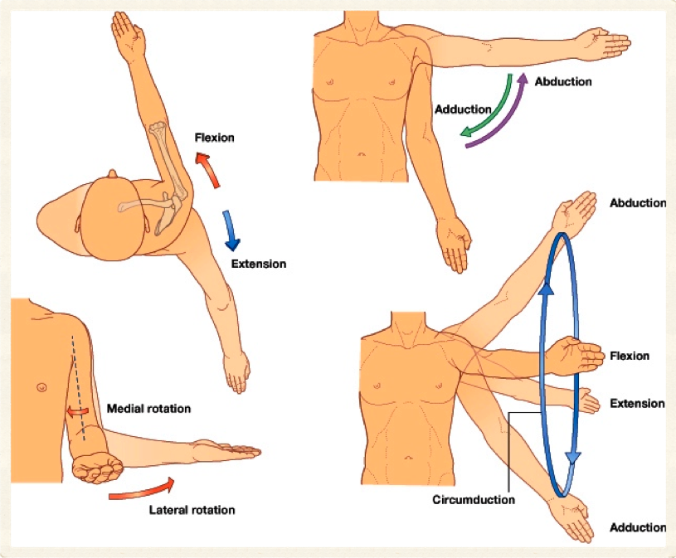
29
Selcuk Tunali, MD, PhD

Slide 30
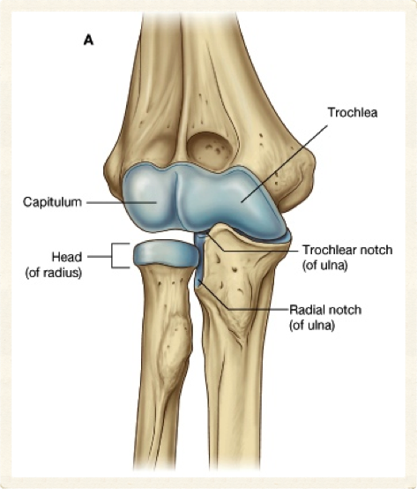
Art. Cubiti – 1
Dirsek eklemi
Art. humero-ulnaris
Art. humero-radialis
Art. radio-ulnaris proximalis
Capsula articularis
30
Selcuk Tunali, MD, PhD

Slide 31
Art. Cubiti – 2
Art. humero-ulnaris
Trochlea humeri
Incisura trochlearis
Ginglymus (art. trochlearis)
Fleksiyon – ekstansiyon
31
Selcuk Tunali, MD, PhD

Slide 32
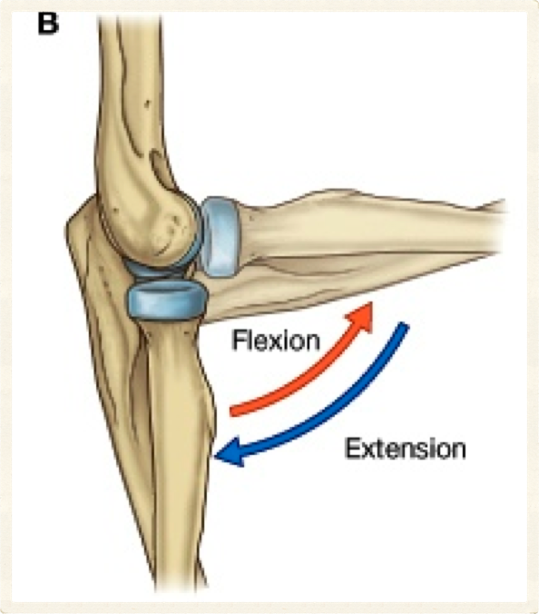
32
Selcuk Tunali, MD, PhD

Slide 33
Art. Cubiti – 3
Art. humero-radialis
Capitulum humeri
Fovea articularis (radius)
Art. spheroidea
Fleksiyon – ekstansiyon
33
Selcuk Tunali, MD, PhD

Slide 34
Art. Cubiti – 4
Art. radio-ulnaris prox.
Incisura radialis
Circumferentia articularis
Art. trochoidea
Pronasyon – supinasyon
34
Selcuk Tunali, MD, PhD

Slide 35
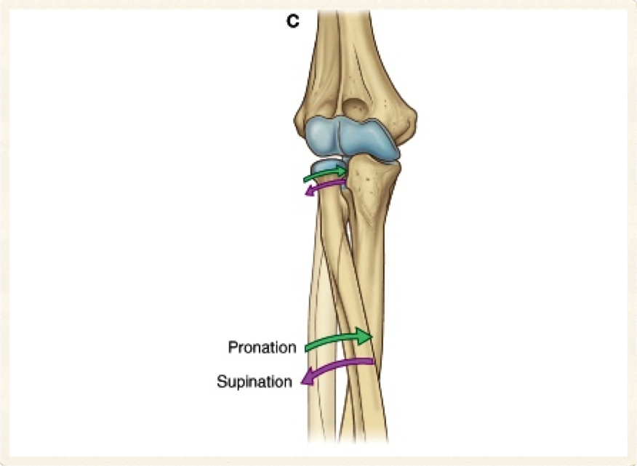
35
Selcuk Tunali, MD, PhD

Slide 36
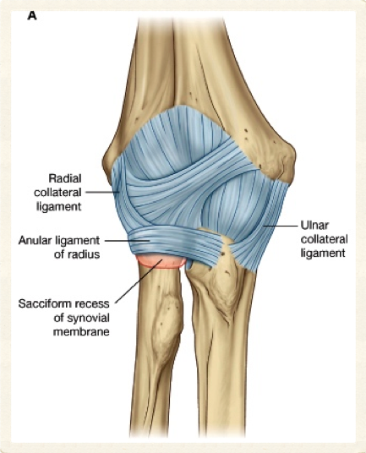
Art. Cubiti – 5
Capsula articularis
Lig. collaterale ulnare
Lig. collaterale radiale
Lig. anulare radii
Lig. quadratum
Chorda obliqua
Membrana interossea
36
Selcuk Tunali, MD, PhD

Slide 37
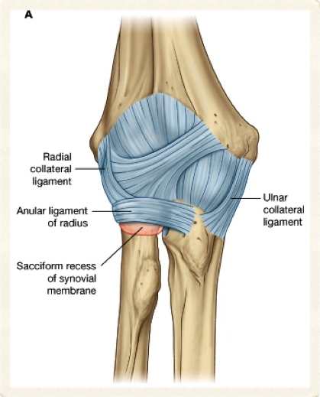
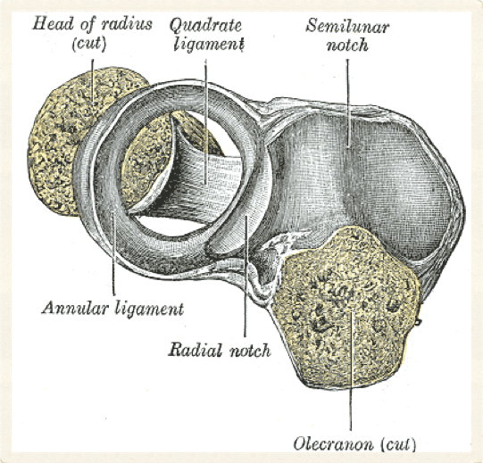
37
Selcuk Tunali, MD, PhD

Slide 38
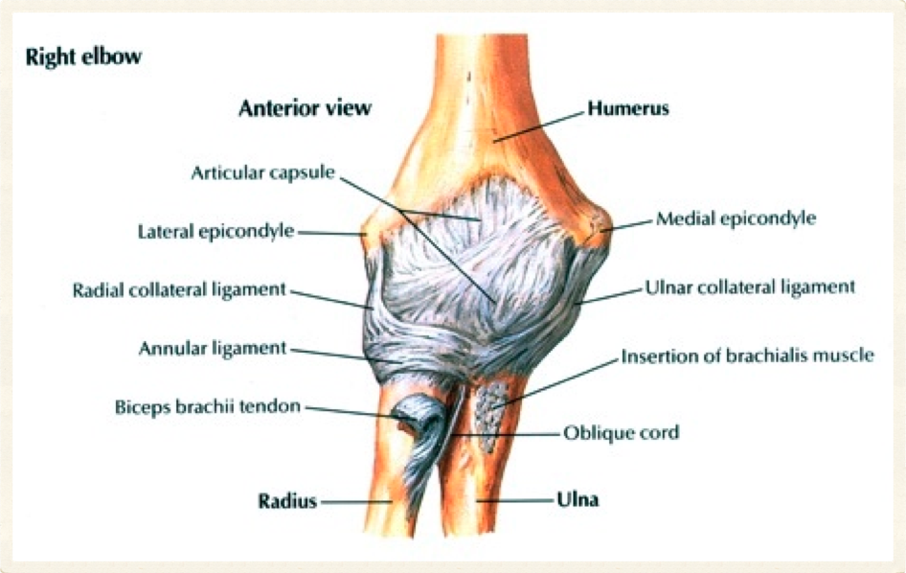
38
Selcuk Tunali, MD, PhD

Slide 39
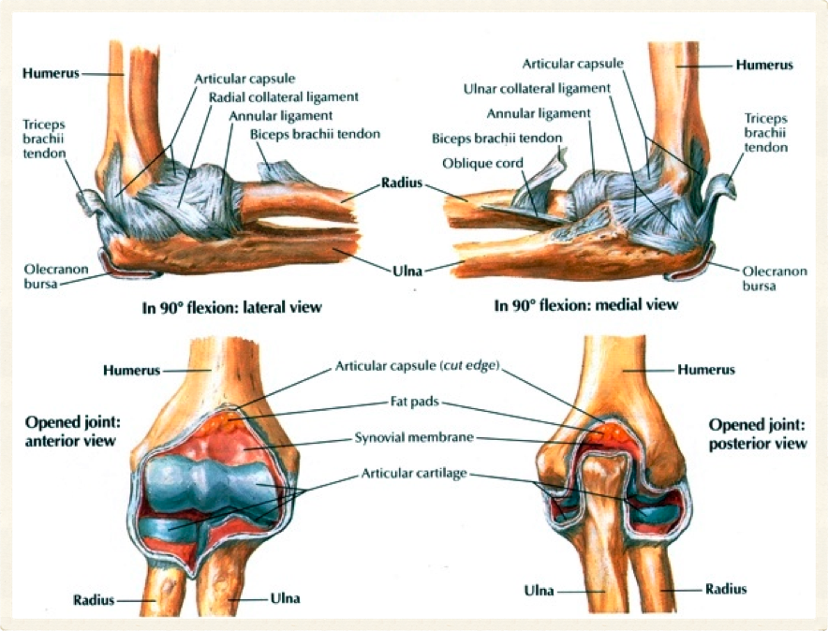
39
Selcuk Tunali, MD, PhD

Slide 40
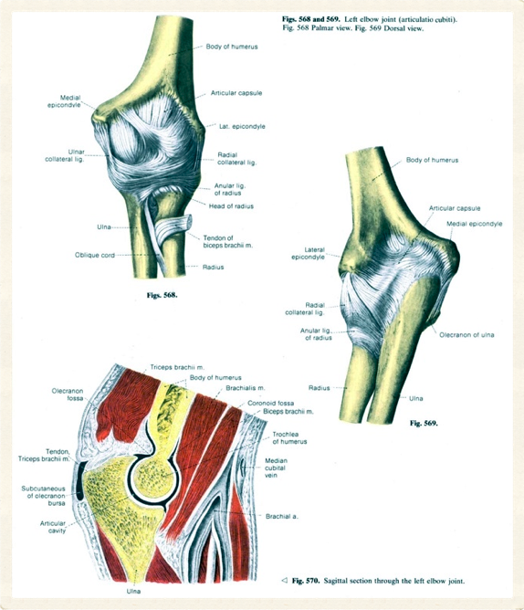
40
Selcuk Tunali, MD, PhD

Slide 41
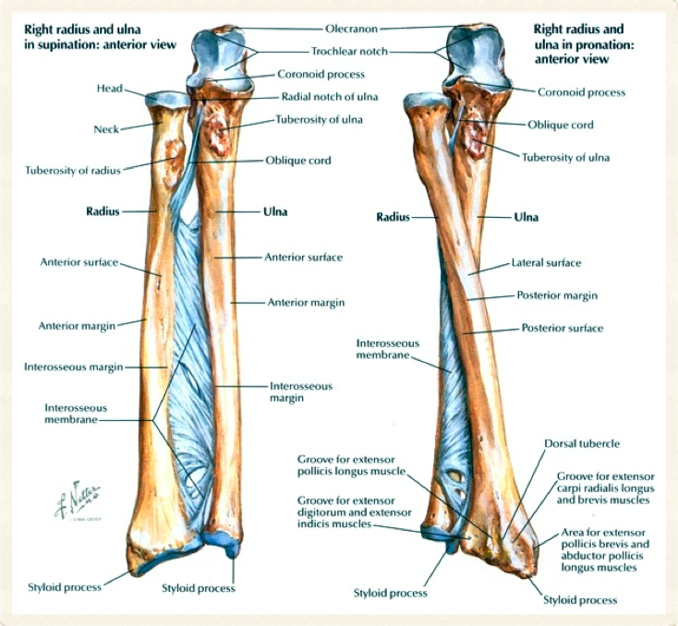
41
Selcuk Tunali, MD, PhD

Slide 42
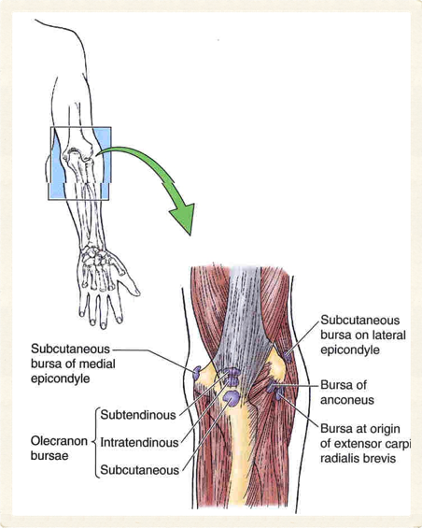
Art. Cubiti – 6
Bursa olecrani
Subcutanea
Intratendinea
Subtendinea
Bursa bicipitoradialis
42
Selcuk Tunali, MD, PhD

Slide 43
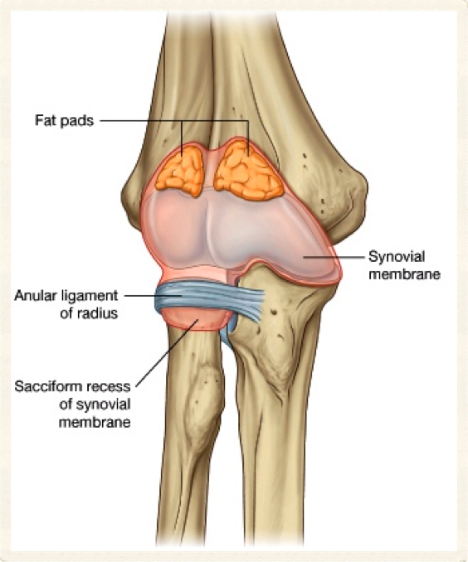
43
Selcuk Tunali, MD, PhD

Slide 44
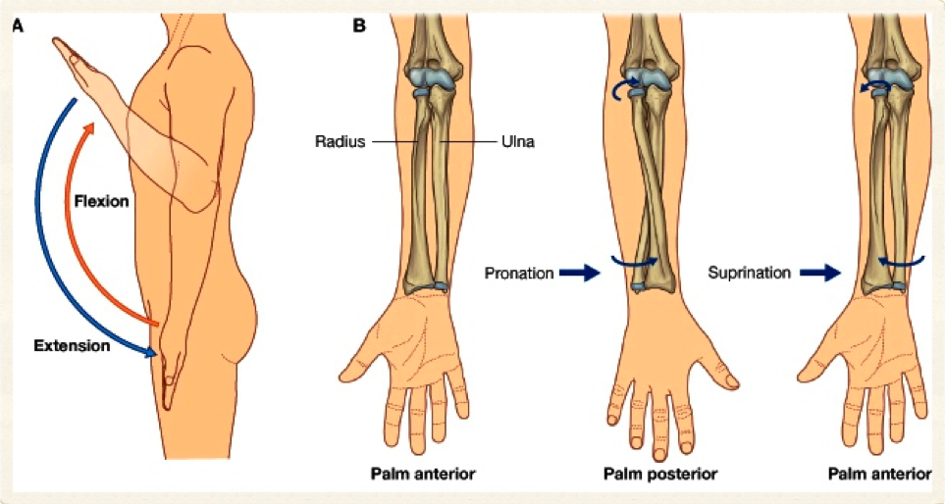
44
Selcuk Tunali, MD, PhD

Slide 45
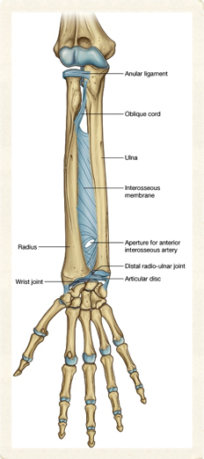
Art. Radio-Ulnaris Distalis
Art. trochoidea
Incisura ulnaris
Caput ulnae
Discus articularis
Capsula articularis
Pronasyon – supinasyon
45
Selcuk Tunali, MD, PhD

Slide 46
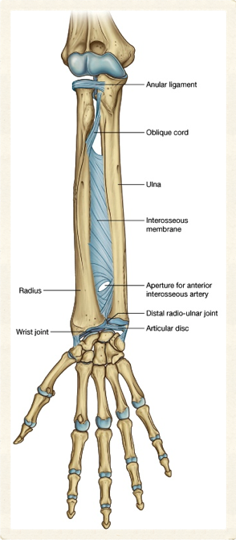
46
Selcuk Tunali, MD, PhD

Slide 47
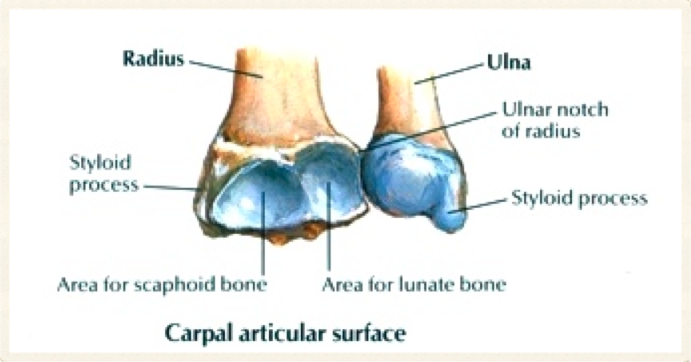
47
Selcuk Tunali, MD, PhD

Slide 48
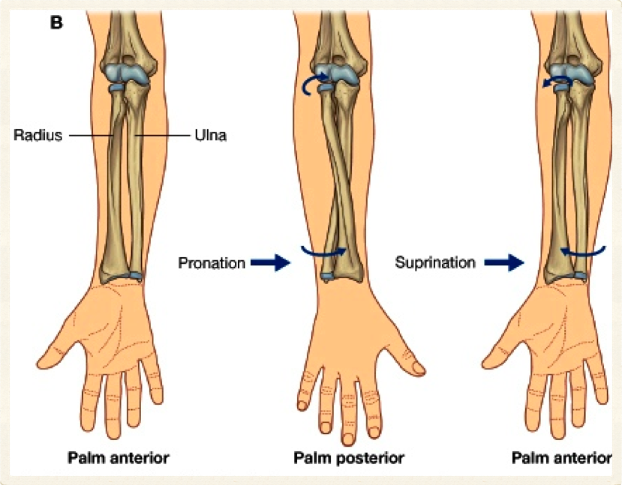
48
Selcuk Tunali, MD, PhD

Slide 49
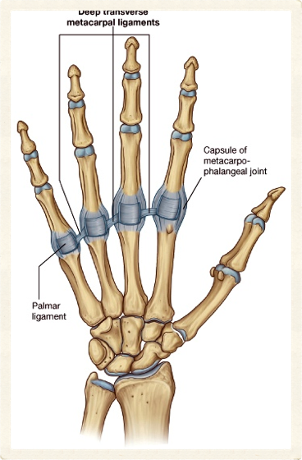
Art. Radiocarpalis – 1
Art. ellipsoidea
Facies articularis carpalis (radius)
Discus articularis
Proksimal sıra karpal kemikler (os pisiforme hariç)
49
Selcuk Tunali, MD, PhD

Slide 50
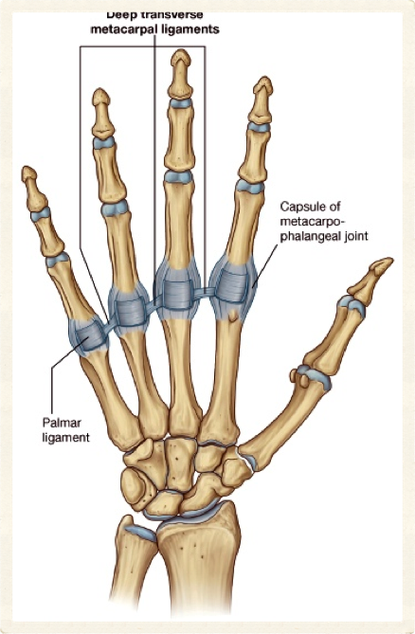
50
Selcuk Tunali, MD, PhD

Slide 51
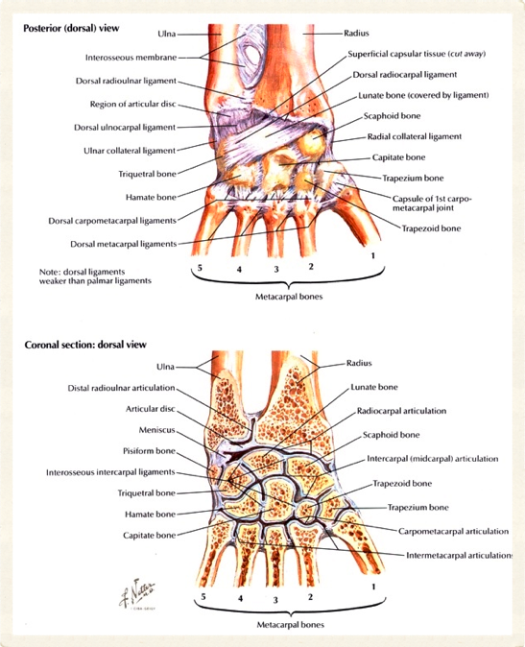
51
Selcuk Tunali, MD, PhD

Slide 52
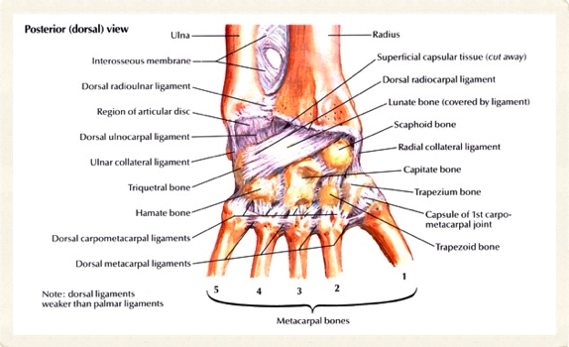
Art. Radiocarpalis – 2
Capsula articularis
Lig. radiocarpale palmare
Lig. radiocarpale dorsale
Lig. ulnocarpale palmare
Lig. ulnocarpale dorsale
Lig. collaterale ulnare
Lig. collaterale radiale
52
Selcuk Tunali, MD, PhD

Slide 53
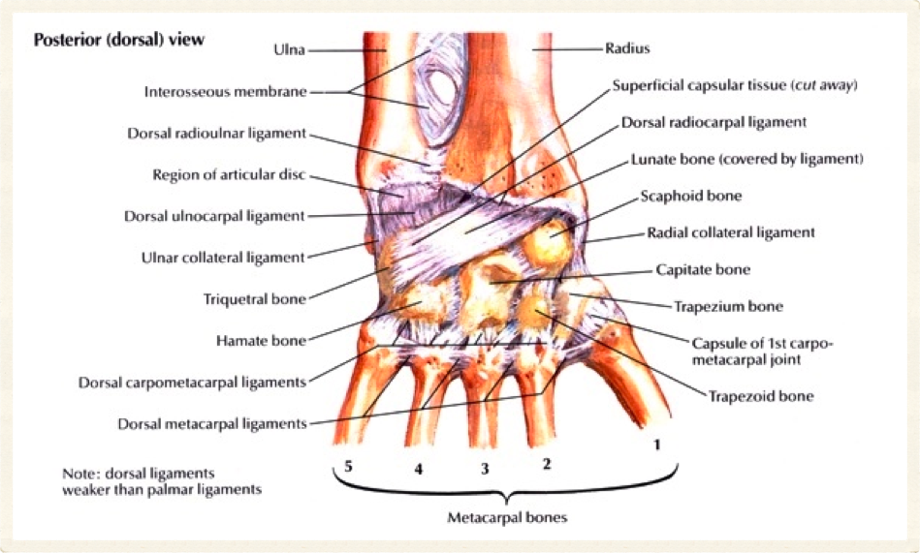
53
Selcuk Tunali, MD, PhD

Slide 54
54
Selcuk Tunali, MD, PhD

Slide 55
Art. Radiocarpalis – 3
Fleksiyon – ekstansiyon
Abduksiyon – adduksiyon
Sirkumdiksiyon
55
Selcuk Tunali, MD, PhD

Slide 56
Articulationes Intercarpales
Karpal kemikler arasında
Art. plana
Ligg. intercarpalia palmaria
Ligg. intercarpalia dorsalia
Ligg. intercarpalia interossea
Kayma hareketi
56
Selcuk Tunali, MD, PhD

Slide 57
57
Selcuk Tunali, MD, PhD

Slide 58
58
Selcuk Tunali, MD, PhD

Slide 59
59
Selcuk Tunali, MD, PhD

Slide 60
60
Selcuk Tunali, MD, PhD

Slide 61
61
Selcuk Tunali, MD, PhD

Slide 62
Art. Mediocarpalis
Proksimal ve distal sıra karpal kemikler
Medialde elipsoid, lateralde plana
Ligg. intercarpalia palmaria
Ligg. intercarpalia dorsalia
Kayma hareketi
62
Selcuk Tunali, MD, PhD

Slide 63
63
Selcuk Tunali, MD, PhD

Slide 64
64
Selcuk Tunali, MD, PhD

Slide 65
65
Selcuk Tunali, MD, PhD

Slide 66
Articulationes Carpometacarpales (II-V)
Distal sıra karpal kemikler
II – V metakarpal kemikler
Art. plana
Ligg. carpometacarpalia palmaria
Ligg. carpometacarpalia dorsalia
Kayma hareketi
66
Selcuk Tunali, MD, PhD

Slide 67
67
Selcuk Tunali, MD, PhD

Slide 68
68
Selcuk Tunali, MD, PhD

Slide 69
69
Selcuk Tunali, MD, PhD

Slide 70
Art. Carpometacarpalis Pollicis
Metakarpal I
Os trapezium
Art. sellaris
Capsula articularis
Fleksiyon – ekstansiyon
Abduksiyon – adduksiyon
Sirkumdiksiyon
70
Selcuk Tunali, MD, PhD

Slide 71
71
Selcuk Tunali, MD, PhD

Slide 72
72
Selcuk Tunali, MD, PhD

Slide 73
73
Selcuk Tunali, MD, PhD

Slide 74
74
Selcuk Tunali, MD, PhD

Slide 75
75
Selcuk Tunali, MD, PhD

Slide 76
Articulationes Intermetacarpales
Metakarpal kemiklerin proksimal uçları
Art. plana
Ligg. metacarpalia dorsalia
Ligg. metacarpalia palmaria
Ligg. metacarpalia interossea
Kayma hareketi
76
Selcuk Tunali, MD, PhD

Slide 77
77
Selcuk Tunali, MD, PhD

Slide 78
78
Selcuk Tunali, MD, PhD

Slide 79
79
Selcuk Tunali, MD, PhD

Slide 80
80
Selcuk Tunali, MD, PhD

Slide 81
Articulationes Metacarpophalangeales – 1
Metakarpal kemiklerin distal uçları
Phalanges proximales proksimal uçları
Art. spheroidea
81
Selcuk Tunali, MD, PhD

Slide 82
82
Selcuk Tunali, MD, PhD

Slide 83
83
Selcuk Tunali, MD, PhD

Slide 84
Articulationes Metacarpophalangeales – 2
Ligg. collateralia
Ligg. palmaria
Lig. metacarpale transversum profundum
Fleksiyon – ekstansiyon
Abduksiyon – adduksiyon
Sirkumdiksiyon
84
Selcuk Tunali, MD, PhD

Slide 85
85
Selcuk Tunali, MD, PhD

Slide 86
86
Selcuk Tunali, MD, PhD

Slide 87
Articulationes Interphalangeales
Phalanges proximales (caput) – phalanges media (basis)
Phalanges media (caput) – phalanges distales (basis)
Ginglymus (art. trochlearis)
Ligg. collateralia
Ligg. palmaria
Fleksiyon – ekstansiyon
87
Selcuk Tunali, MD, PhD

Slide 88
88
Selcuk Tunali, MD, PhD

Slide 89
89
Selcuk Tunali, MD, PhD

Slide 90
90
Selcuk Tunali, MD, PhD

Slide 91
stunali@etu.edu.tr
selcuk@hawaii.edu
http://twitter.com/tunalis
http://www.tunalis.org

