Slide 1
ÜST EKSTREMİTE KEMİKLERİ
Dr. Selçuk TUNALI
TOBB ETÜ, 8 Eylül 2014

Slide 2
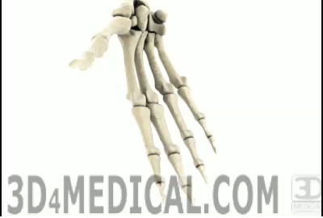
2
Selcuk Tunali, MD, PhD

Slide 3
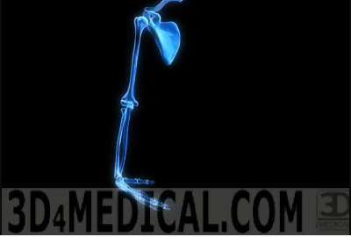
3
Selcuk Tunali, MD, PhD

Slide 4
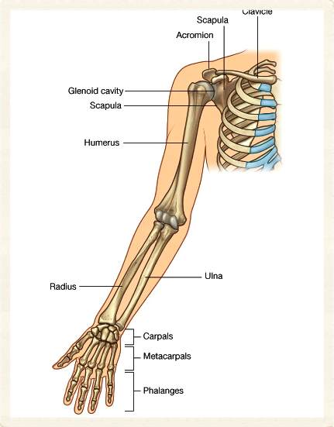

Üst Ekstremite Kemikleri
Clavicula
Scapula
Humerus
Ulna
Radius
Ossa carpi
Ossa metacarpi
Phalanges
4
Selcuk Tunali, MD, PhD

Slide 5

Clavicula-1
Üst ekstremiteyi gövdeye bağlar
Şok enerjisini aksiyal iskelete iletir
Manubrium – acromion arası
Horizontale yakın
Tamamen cilt altında
Çift eğrilik
5
Selcuk Tunali, MD, PhD

Slide 6
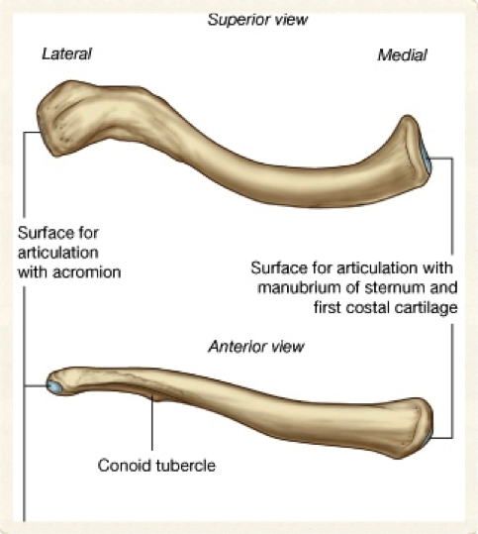
Clavicula-2
Corpus (şaft)
  Kıvrımlı
  Medial 2/3 öne konveks
  Lateral 1/3 öne konkav
Extremitas acromialis – düz
Extremitas sternalis – geniş
6
Selcuk Tunali, MD, PhD

Slide 7
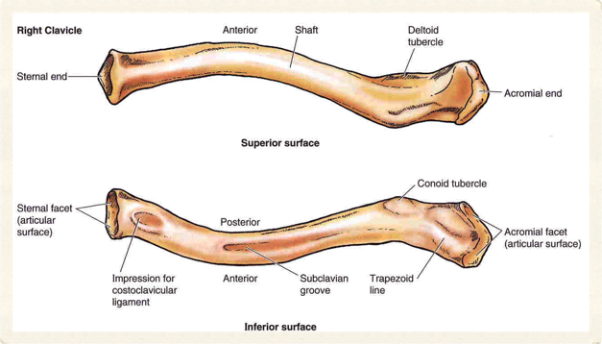
Clavicula-3
Facies superior
  Deltoid tubercle
Facies inferior
  Tuberculum conoideum
  Linea trapezoidea
  Sulcus musculi subclavii
  Impressio lig. costoclavicularis
7
Selcuk Tunali, MD, PhD

Slide 8
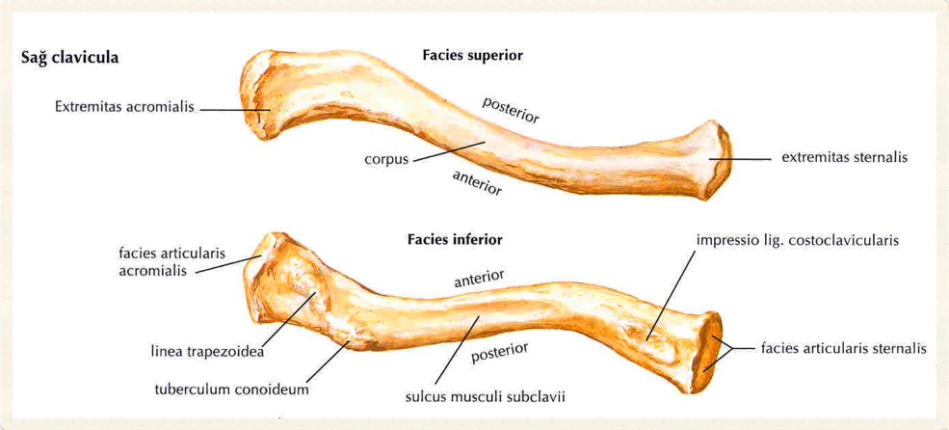
8
Selcuk Tunali, MD, PhD

Slide 9
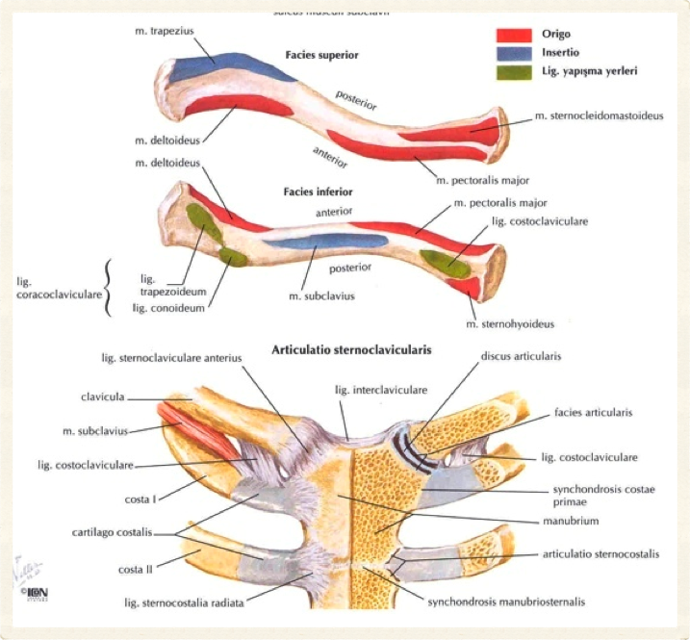
9
Selcuk Tunali, MD, PhD

Slide 10
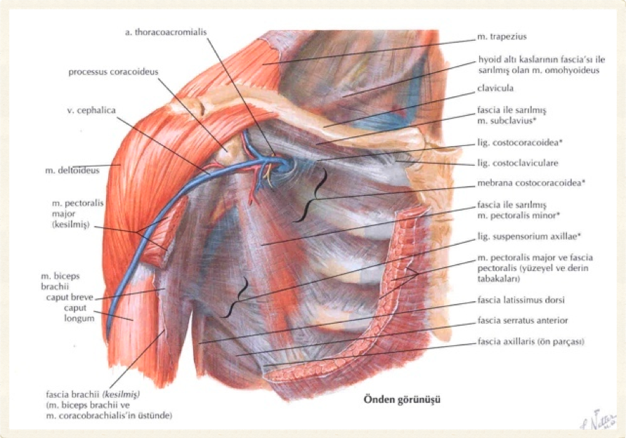
10
Selcuk Tunali, MD, PhD

Slide 11
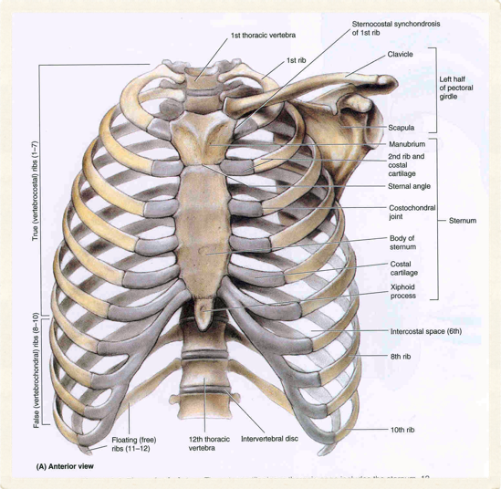
Scapula-1
Düz
Üçgen
Thorax posterolateral yüzünde
2–7 costae
Facies costalis
Facies posterior
11
Selcuk Tunali, MD, PhD

Slide 12
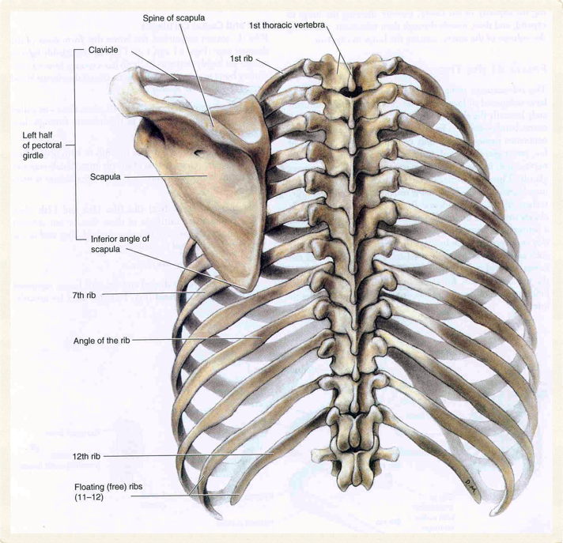
12
Selcuk Tunali, MD, PhD

Slide 13
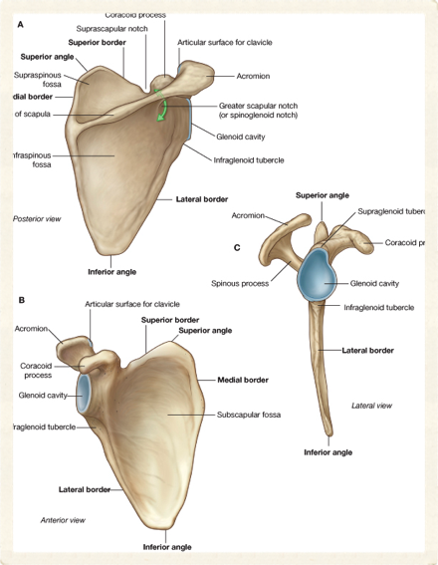
Scapula-2
Kenarlar (margo)
  Superior
  Lateral
  Medial
Köşeler (angulus)
  Inferior
  Superior
  Lateral
13
Selcuk Tunali, MD, PhD

Slide 14
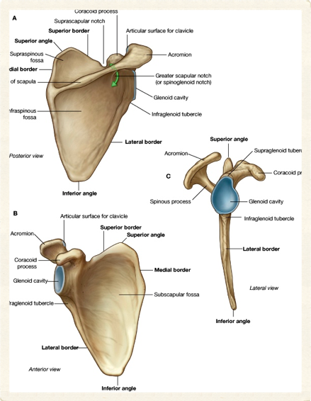
Scapula-3
Spina scapulae
Acromion
Processus coracoideus
14
Selcuk Tunali, MD, PhD

Slide 15
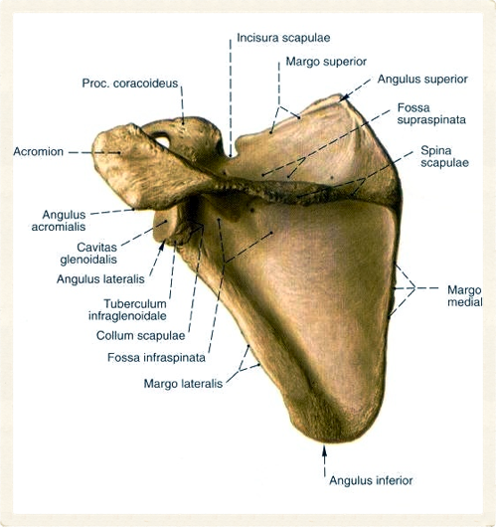
Scapula-4
Spina scapulae
  Fossa supraspinata
  Fossa infraspinata
  Trigonum spinae
  Ilinea interspinalis: T4
15
Selcuk Tunali, MD, PhD

Slide 16
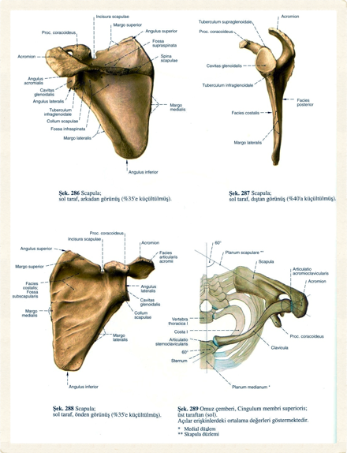
Scapula-5
Acromion
  Öne doğru
  Subkutan landmark
  Medial kenar – clavicula
  Lateral kenar – palpabl
Processus coracoideus
  Anterolateral
  Karga gagası
16
Selcuk Tunali, MD, PhD

Slide 17
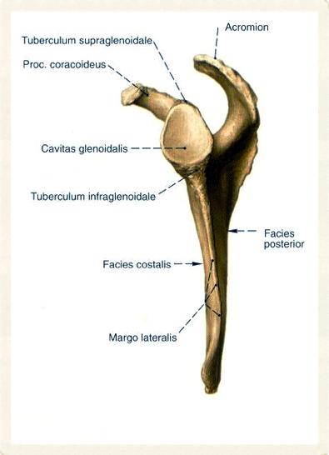
Scapula-6
Cavitas glenoidalis
Tuberculum supraglenoidale
Tuberculum infraglenoid ale
Incisura scapulae
17
Selcuk Tunali, MD, PhD

Slide 18
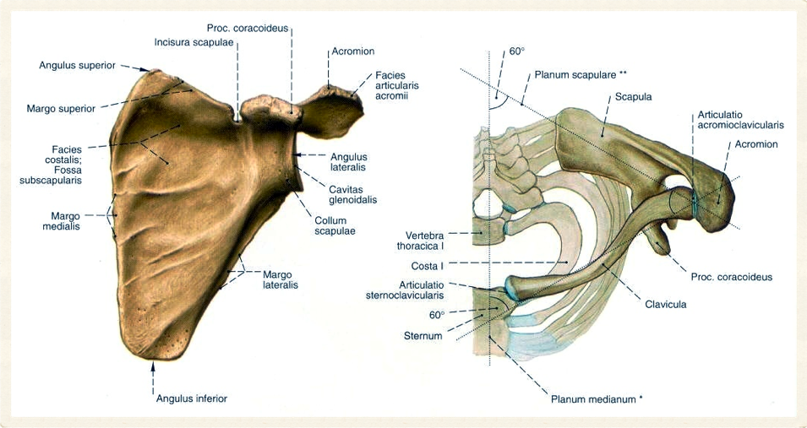
18
Selcuk Tunali, MD, PhD

Slide 19
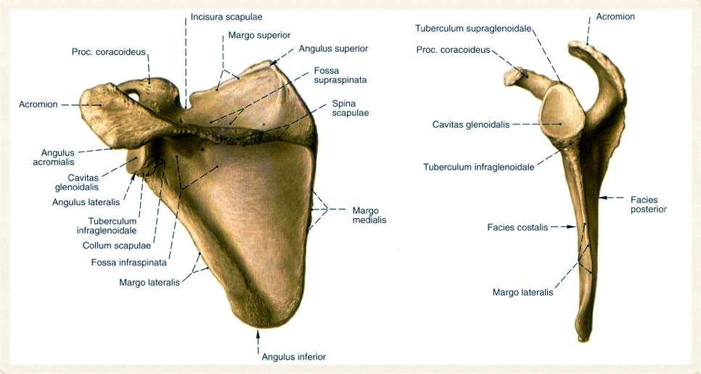
19
Selcuk Tunali, MD, PhD

Slide 20
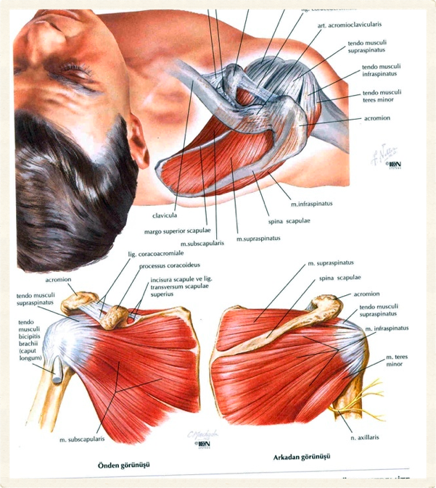
20
Selcuk Tunali, MD, PhD

Slide 21
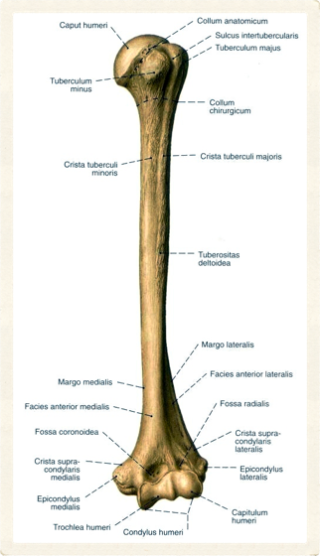
Humerus-1
Üst ekstremitede en büyük
Extremitas proximalis
  Caput humeri
  Collum humeri
  Tuberculum majus
  Tuberculum minus
21
Selcuk Tunali, MD, PhD

Slide 22
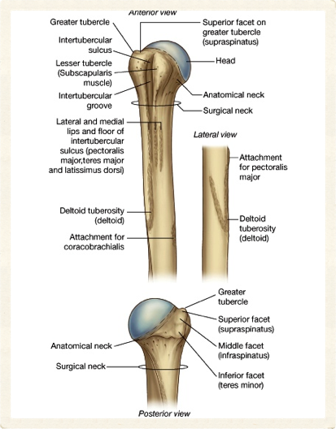
Humerus-2
Caput – cavitas glenoidalis
Collum chirurgicum
Collum anatomicum
  Caput ile tüberküller arasında
22
Selcuk Tunali, MD, PhD

Slide 23
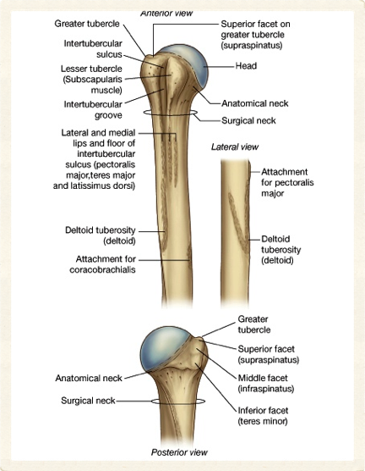
Humerus-3
Tuberculi majus & minus
Majus – lateral
Minus – anterior
Crista tuberculi majoris / minoris
Sulcus intertubercularis (bicipital)
Tüberküllerin aşağısında cerrahi boyun
23
Selcuk Tunali, MD, PhD

Slide 24
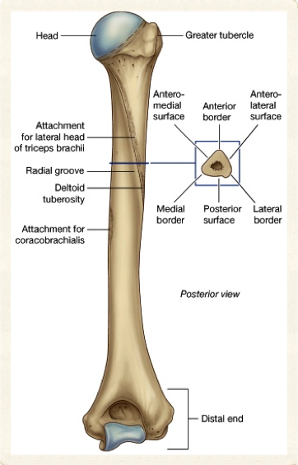
Humerus-4
Corpus
Tuberositas deltoidea
  Lateral
  M. deltoideus
Sulcus nervi radialis
  Posterior
  N. radialis
  A. profunda brachii
24
Selcuk Tunali, MD, PhD

Slide 25
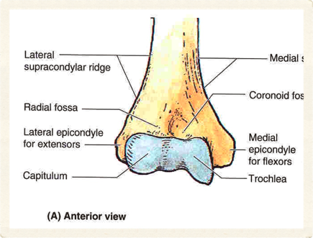
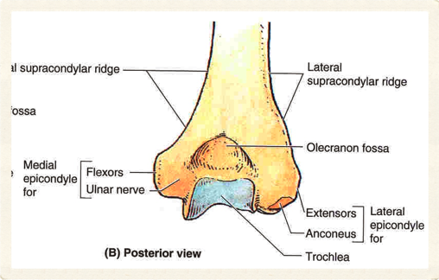
Humerus-5
Extremitas distalis
Trochlea humeri
Capitulum humeri
Epicondylus medialis
Epicondylus lateralis
Sulcus nervi ulnaris
25
Selcuk Tunali, MD, PhD

Slide 26
Humerus-6
Fossa coronoidea
Fossa radialis
Fossa olecrani
26
Selcuk Tunali, MD, PhD

Slide 27
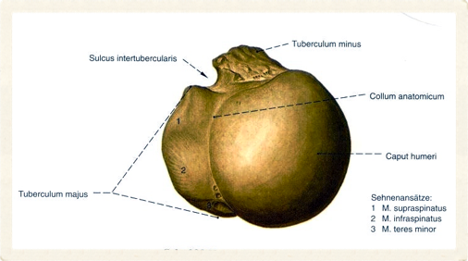
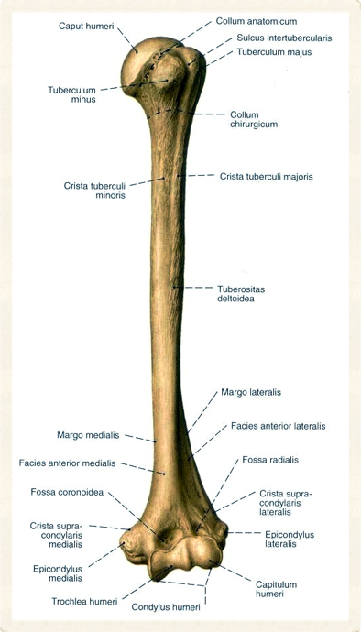
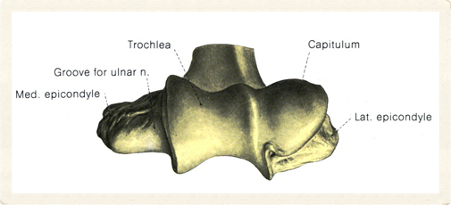
27
Selcuk Tunali, MD, PhD

Slide 28
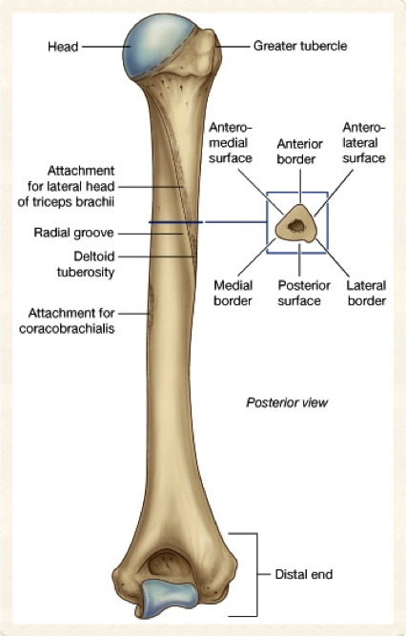
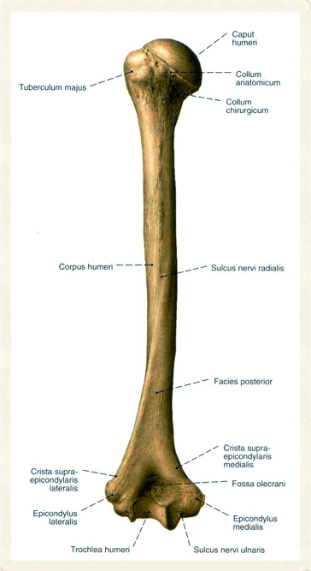
28
Selcuk Tunali, MD, PhD

Slide 29
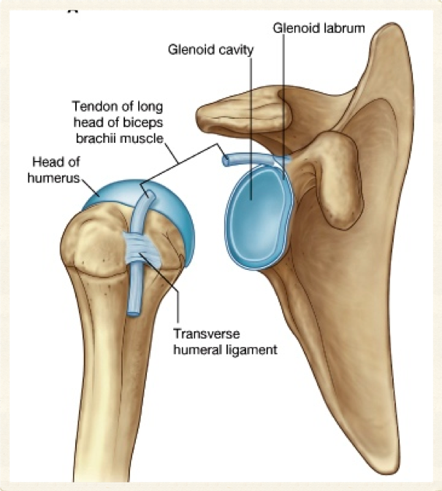
29
Selcuk Tunali, MD, PhD

Slide 30
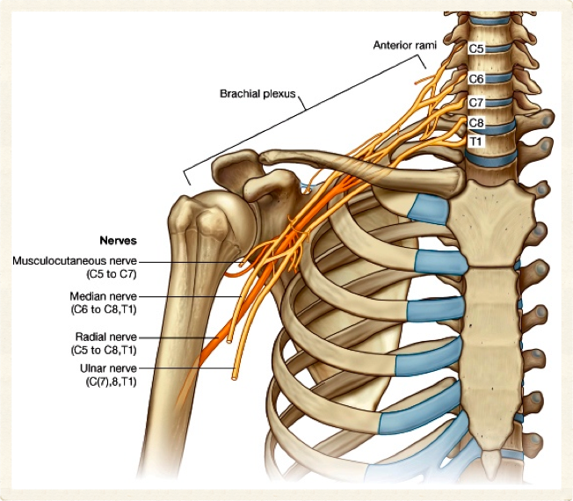
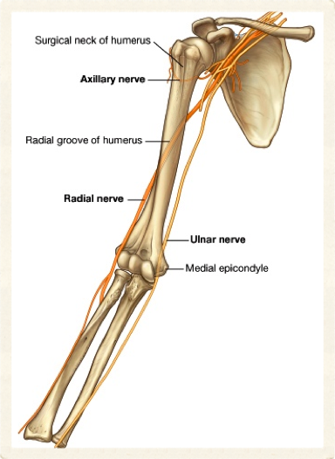
30
Selcuk Tunali, MD, PhD

Slide 31
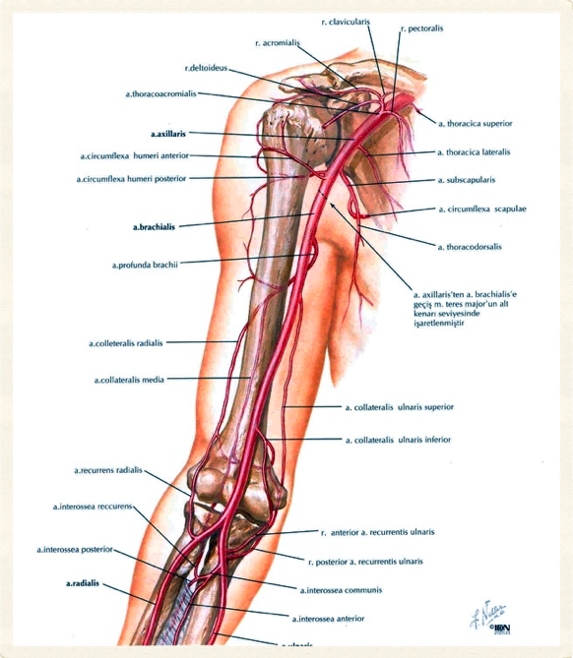
31
Selcuk Tunali, MD, PhD

Slide 32
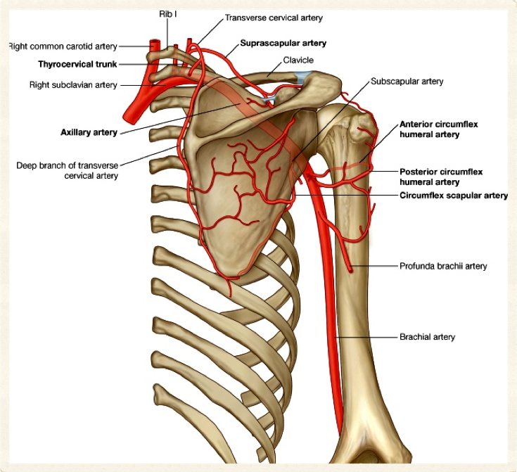
32
Selcuk Tunali, MD, PhD

Slide 33
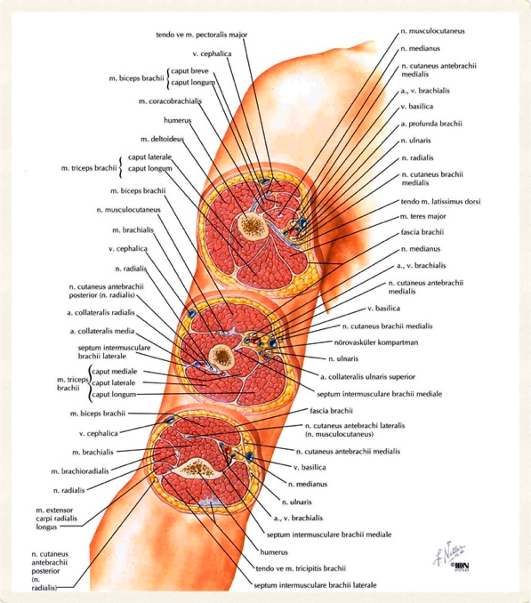
33
Selcuk Tunali, MD, PhD

Slide 34
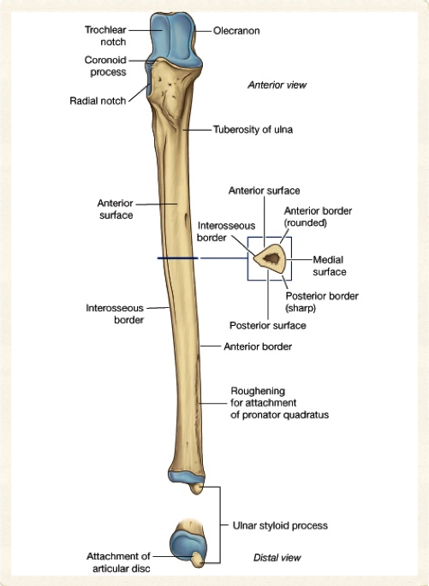
Ulna-1
Medial
Extremitas proximalis
  Olecranon
  Proc. coronoideus
  Incisura trochlearis
  Incisura radialis
  Tuberositas ulna
  Crista musculi supinatorius
34
Selcuk Tunali, MD, PhD

Slide 35
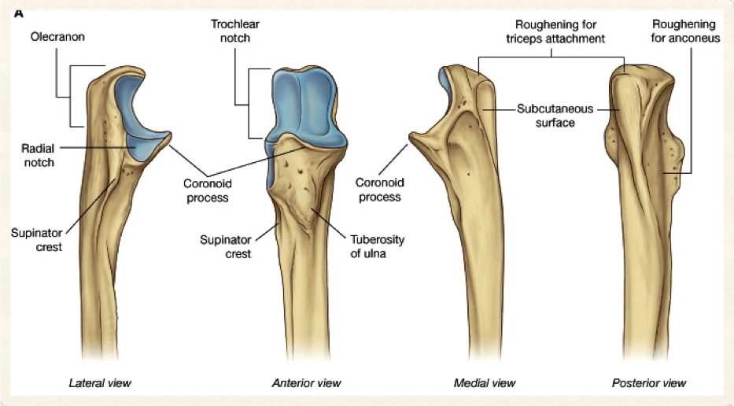
35
Selcuk Tunali, MD, PhD

Slide 36
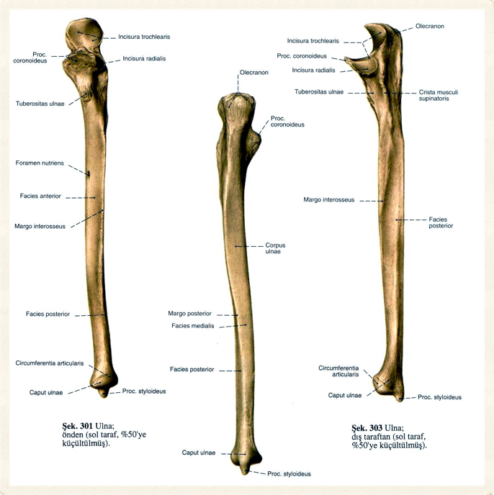
36
Selcuk Tunali, MD, PhD

Slide 37
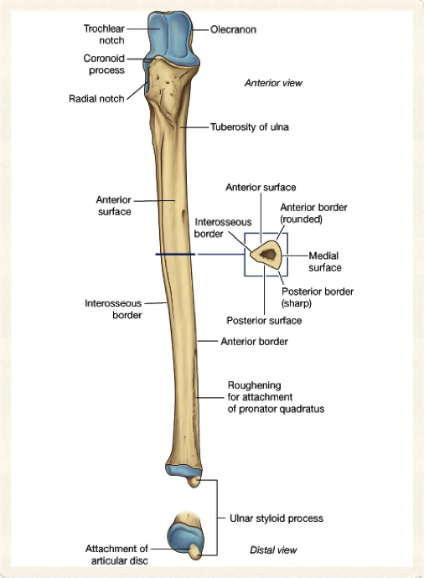
Ulna-2
Corpus
  Facies anterior
  Facies posterior
  Facies medialis
Margo anterior
Margo posterior
Margo interossea
37
Selcuk Tunali, MD, PhD

Slide 38
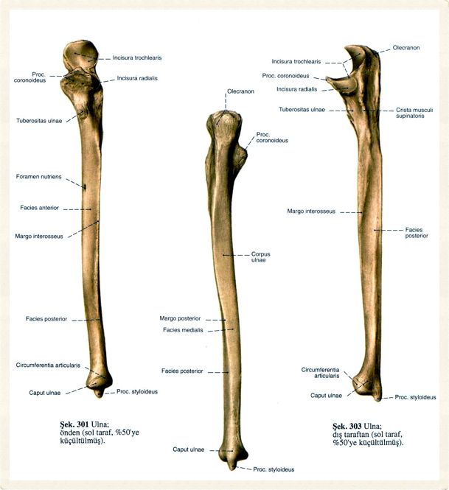
Ulna-3
Extremitas distalis
  Caput ulnae – incisura ulnaris radii radius
  Processus styloideus
38
Selcuk Tunali, MD, PhD

Slide 39
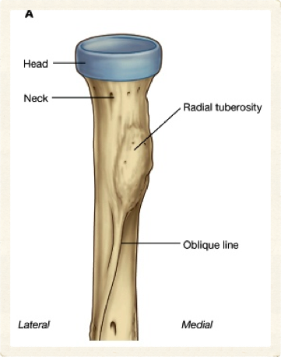
Radius-1
Lateral
Extremitas proximalis
  Caput radii – kısa, silindirik
  Collum radii
  Tuberositas radii
39
Selcuk Tunali, MD, PhD

Slide 40
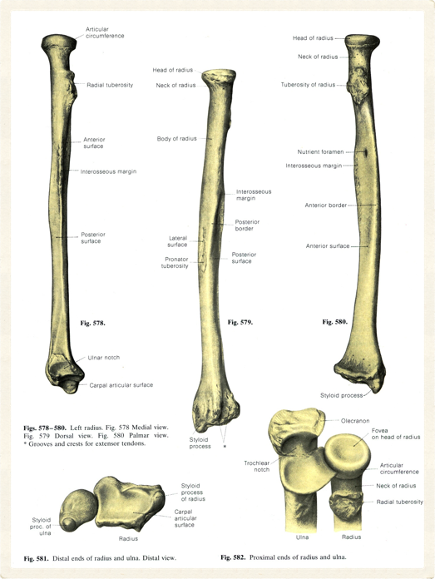
Radius-2
Corpus
  Laterale konveks
  Aşağıya doğru kalınlaşır
Extremitas distalis
  Incisura ulnaris
  Processus styloideus radii
40
Selcuk Tunali, MD, PhD

Slide 41
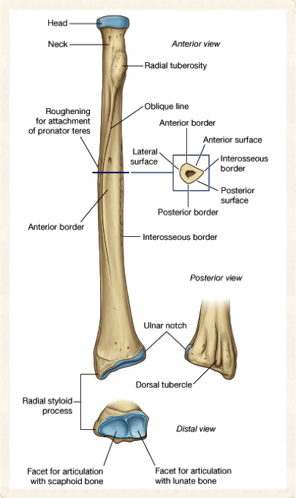
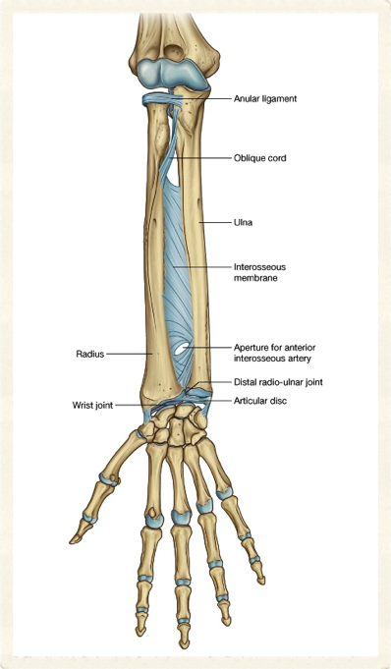
41
Selcuk Tunali, MD, PhD

Slide 42
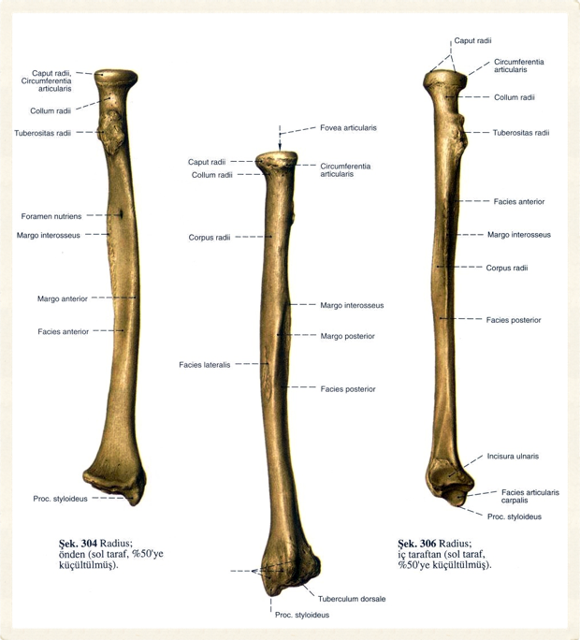
42
Selcuk Tunali, MD, PhD

Slide 43
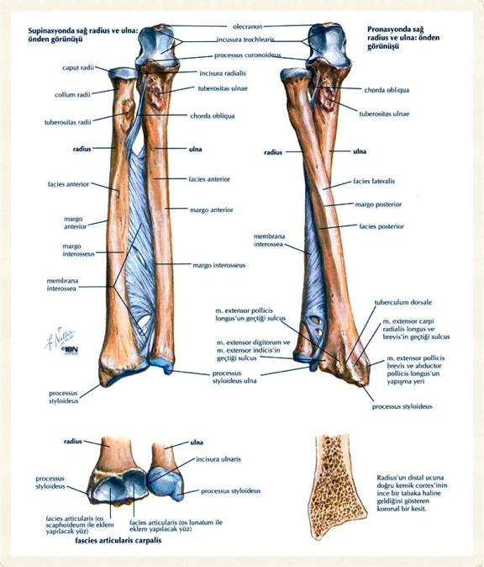
43
Selcuk Tunali, MD, PhD

Slide 44
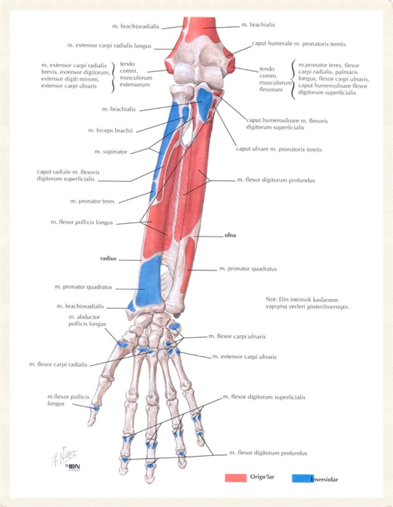
44
Selcuk Tunali, MD, PhD

Slide 45
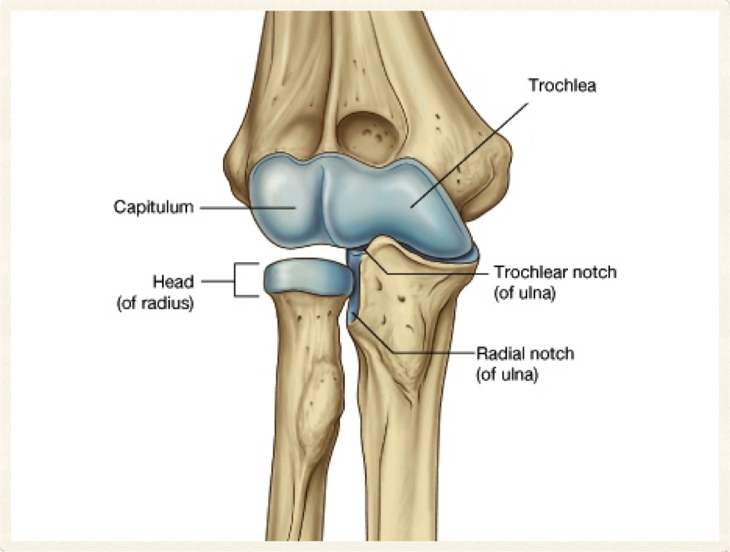
45
Selcuk Tunali, MD, PhD

Slide 46
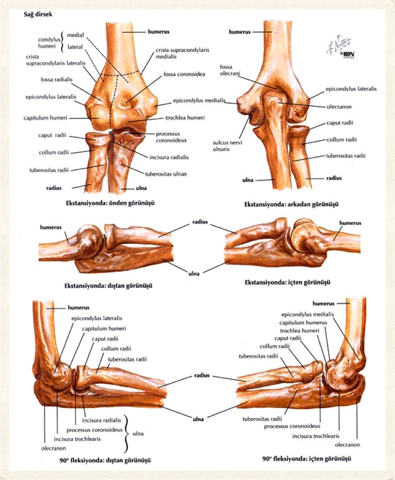
46
Selcuk Tunali, MD, PhD

Slide 47
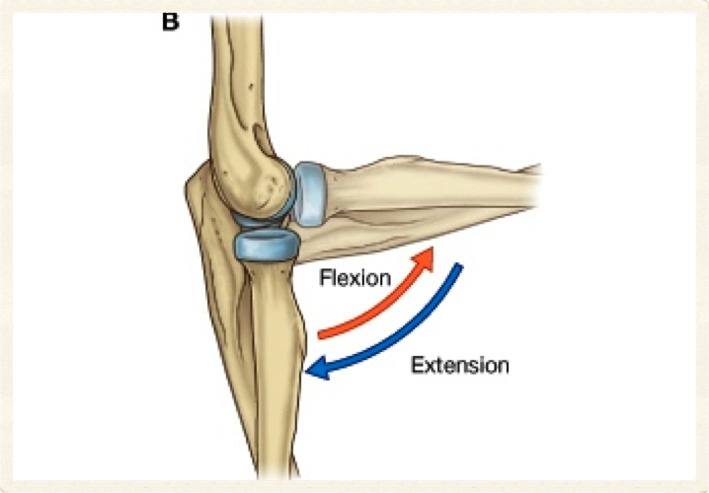

47
Selcuk Tunali, MD, PhD

Slide 48

48
Selcuk Tunali, MD, PhD

Slide 49

Ossa Carpi
Proksimal sıra
  Os scaphoideum
  Os lunatum
  Os triquetrum
  Os pisiforme
Distal sıra
  Os trapezium
  Os trapezoideum
  Os capitatum
  Os hamatum
49
Selcuk Tunali, MD, PhD

Slide 50

50
Selcuk Tunali, MD, PhD

Slide 51


51
Selcuk Tunali, MD, PhD

Slide 52


52
Selcuk Tunali, MD, PhD

Slide 53

53
Selcuk Tunali, MD, PhD

Slide 54

Ossa Metacarpi
Lateralden mediale
  I, II, III, IV, V
Basis (proximal)
Corpus
Caput (distal)
54
Selcuk Tunali, MD, PhD

Slide 55

Phalanges
Phalanx
  Proximalis
  Medius
  Distalis
Baş parmak – 2 phalanges
55
Selcuk Tunali, MD, PhD

Slide 56


56
Selcuk Tunali, MD, PhD

Slide 57

57
Selcuk Tunali, MD, PhD

Slide 58


58
Selcuk Tunali, MD, PhD

Slide 59


59
Selcuk Tunali, MD, PhD

Slide 60


60
Selcuk Tunali, MD, PhD

Slide 61


61

Slide 62

62
Selcuk Tunali, MD, PhD

Slide 63

63
Selcuk Tunali, MD, PhD

Slide 64

64
Selcuk Tunali, MD, PhD

Slide 65


Kırık
Normal
65
Selcuk Tunali, MD, PhD

Slide 66

Os scaphoideum kırığı
66
Selcuk Tunali, MD, PhD

Slide 67

67
Selcuk Tunali, MD, PhD

Slide 68

68
Selcuk Tunali, MD, PhD

Slide 69

69
Selcuk Tunali, MD, PhD

Slide 70


70
Selcuk Tunali, MD, PhD

Slide 71

71
Selcuk Tunali, MD, PhD

Slide 72

72
Selcuk Tunali, MD, PhD

Slide 73

73
Selcuk Tunali, MD, PhD

Slide 74

stunali@etu.edu.tr
selcuk@hawaii.edu
http://twitter.com/tunalis
http://www.tunalis.org

